Slide 1
Module 4 Cryptography and Public Key Infrastructure – Part 1

Slide 2
Module 4 Learning Objectives
On successful completion of this module, students should be able to:
identify and describe three types of cryptography
list and describe current mainstream cryptographic algorithms
explain how cryptography is applied for security
describe how the basics of public key infrastructures are implemented
describe the role of certificate authorities and certificate repositories
describe a digital certificate and its lifecycle conceptually
explain the relationship between trust and certificate verification
identify centralised and decentralised public key infrastructures
describe public and in-house certificate authorities.

Slide 3
Module 4 Learning Resources
Conklin et al. 2016, Principles of computer security: CompTIA Security+, 4th edn.
The readings from the text for this section are ‘Chapter 5 – Cryptography’ pp. 90-127 and ‘Chapter 6 Public key infrastructure’, pp. 128-165.

Slide 4
Key Terms
Algorithm
Block cipher
Ciphertext
Collision attack
Confusion
Cryptanalysis
Cryptography
Differential cryptanalysis
Diffusion
Digital rights management
Digital signature
Entropy
Ephemeral keys
Hash
Key
Notes:
Algorithm – A step-by-step procedure; typically an established computation for solving a problem within a set number of steps.
Block cipher – A cipher that operates on blocks of data.
Collision attack – An attack on a hash function, in which a specific input is generated to produce a hash function output that matches another input.
Confusion – A principle that, when employed, makes each character of ciphertext dependent on several parts of the key.
Cryptanalysis – The process of attempting to break a cryptographic system.
Cryptography – The art of secret writing that enables an individual to hide the contents of a message or file from all but the intended recipient.
Differential cryptanalysis – A form of cryptanalysis that uses different inputs to study how outputs change in a structured manner.
Diffusion – A principle that the statistical analysis of plaintext and ciphertext results in a form of dispersion rendering one structurally independent of the other. In plain terms, a change in one character of plaintext should result in multiple changes in the ciphertext in a manner that changes in ciphertext do not reveal information as to the structure of the plaintext.
Digital rights management – The control of user activities associated with a digital object via technological means.
Digital signature – A cryptography-based artifact that is a key component of a public key infrastructure (PKI) implementation. A digital signature can be used to prove identity because it is created with the private key portion of a public/private key pair. A recipient can decrypt the signature and, by doing so, receive the assurance that the data must have come from the sender and that the data has not changed.
Entropy – The measure of uncertainty associated with a series of values. Perfect entropy equates to complete randomness, such that given any string of bits, there is no computation to improve guessing the next bit in the sequence.
Ephemeral keys – Cryptographic keys that are used only once after they are generated.
Hash – Form of encryption that creates a digest of the data put into the algorithm. These algorithms are referred to as one-way algorithms because there is no feasible way to decrypt what has been encrypted.
Key – In cryptography, a sequence of characters or bits used by an algorithm to encrypt or decrypt a message.

Slide 5
Key Terms (continued)
Key escrow
Key management
Keyspace
Key stretching
Linear cryptanalysis
Multiple encryption
Plaintext
Shared secret
Shift cipher
Steganography
Stream cipher
Substitution
Transposition
Transposition cipher
Trapdoor function
Vigenère cipher
XOR
Notes:
Key escrow – The process of placing a copy of cryptographic keys with a trusted third party for backup purposes.
Key management – The exchange, storage, safeguarding, and revocations of keys.
Keyspace – The entire set of all possible keys for a specific encryption algorithm.
Key stretching – A mechanism that takes what would be weak keys and “stretches” them to make the system more secure against brute-force attacks.
Linear cryptanalysis – The use of linear functions to approximate a cryptographic function as a means of analysis.
Multiple encryption – The use of multiple layers of encryption to improve encryption strength.
Plaintext – In cryptography, a piece of data that is not encrypted. It can also mean the data input into an encryption algorithm that would output ciphertext.
Shared secret – Both the sender and the receiver of encrypted messages have the same key.
Shift cipher – one letter of the alphabet is shifted a set number of places in the alphabet for another letter.
Steganography – The hiding of data inside of other data.
Stream cipher – A stream cipher works by enciphering the plaintext in a stream, usually bit by bit.
Substitution – The switching of one value for another in cryptography.
Transposition – The rearrangement of characters by position as part of cryptographic operations.
Transposition cipher – The characters of a message are used but the order is changed.
Trapdoor function – A hidden method used to gain access to a computer system, network or application. Often used by software developers to ensure unrestricted access to the systems they create. Synonymous with trapdoor.
Vigenère cipher – A polyalphabetic substitution cipher that depends on a password.
XOR – Bitwise exclusive OR, an operation commonly used in cryptography.

Slide 6
Introduction
Cryptography is the science of encrypting, or hiding, information
Ciphers are complicated methods, cryptographic algorithms, for concealing information
Plaintext is protected from unauthorized interception or alteration encrypting it into ciphertext
An algorithm and a key are employed
Notes:
In the beginning, people in power attempted to hide information by controlling who was taught to read and write. Eventually, more complicated methods of concealing information by shifting letters around to make the text unreadable were developed. These complicated methods are called cryptographic algorithms, also known as ciphers. The word cipher comes from the Arabic word sifr, meaning empty or zero.

Slide 7
Introduction (continued)
Cryptanalysis – the process of analyzing available information in an attempt to return the encrypted message to its original form
Differential cryptanalysis – compares the input plaintext to the output ciphertext to try and determine the key used to encrypt the information
Linear cryptanalysis – uses both plaintext and ciphertext; puts the plaintext through a simplified cipher to try and deduce what the key is likely to be in the full version of the cipher

Slide 8
Cryptography in Practice
Cryptography is much more than encryption
Data protection
Data hiding
Integrity checks
Nonrepudiation services
Policy enforcement
Key management and exchange

Slide 9
Cryptography in Practice (continued)
Strong cryptography is rendered weak via implementation mistakes such as:
Known plaintext attacks
Poorly protected keys
Repeated passphrases
The weaknesses in cryptosystems come from the system surrounding the algorithm, implementation, and operationalization details.

Slide 10
Levels of Protection of a Cryptosystem
Descending list of risks/benefits
The mechanism is no longer useful for any purpose.
The cost of recovering the clear text without benefit of the key has fallen to a low level.
The cost has fallen to equal to or less than the value of the data or the next least cost attack.
The cost has fallen to within several orders of magnitudes of the cost of encryption or the value of the data.

Slide 11
Descending List of Risks/Benefits (continued)
The elapsed time of attack has fallen to within magnitudes of the life of the data, regardless of the cost thereof.
The cost has fallen to less than the cost of a brute-force attack against the key?
Someone has recovered one key or one message.

Slide 12
Fundamental Methods
Modern cryptographic operations are performed using both an algorithm and a key.
Cryptographic operations include:
Encryption (for the protection of confidentiality), hashing (for the protection of integrity), digital signatures (to manage nonrepudiation), and a bevy of specialty operations such as key exchanges
Notes:
Security+ objective 6.1i Use of Proven Technologies

Slide 13
Fundamental Methods (continued)
The methods used to encrypt information are based on two separate operations:
Substitution – replacing an item with a different item
Transposition – changing the order of items
Modern cryptography is built around complex mathematical functions.
Integrity protection operations are characterized by the level of assurance desired.
Notes:
Security+ objective 6.1i Use of Proven Technologies

Slide 14
Fundamental Methods (continued)
Data can be characterized by:
Its state – data in transit, data at rest, or data in use
How it is used – block form or stream form
Notes:
Security+ objective 6.1i Use of Proven Technologies

Slide 15
Comparative Strengths and Performance of Algorithms
Strength of a cryptographic algorithm depends on:
Size of the key and the resulting keyspace, a set of every possible key value
Brute force is one method of attack.
Work factor is a subjective measurement of the time and effort needed to perform operations.
Low work factor means a larger keyspaces are needed
Notes:
Tech Tip: Keyspace Comparisons
Because the keyspace is a numeric value, it is very important to ensure that comparisons are done using similar key types. Comparing a key made of 1 bit (2 possible values) and a key made of 1 letter (26 possible values) would not yield accurate results. Fortunately, the widespread use of computers has made almost all algorithms state their keyspace values in terms of bits.

Slide 16
Comparative Strengths and Performance of Algorithms (continued)
A larger keyspace allows the use of keys of greater complexity, and therefore more security, assuming the algorithm is well designed.
When an algorithm lists a certain number of bits as a key, it is defining the keyspace.
Many algorithms have repeated cycles to add to the work and reduce the ability to parallelize operations inside processor chips.

Slide 17
Historical Perspective
Humans have been designing secret communication systems for as long they have needed to keep communication private.
Spartans of ancient Greece used a transposition cipher, where the same letters are used but the order is changed
In all cipher systems:
Plaintext is the unencrypted input text
Ciphertext is the encrypted output

Slide 18
Substitution Ciphers
Other background information
Romans typically used a shift cipher.
A modern-day example of a shift cipher is the ROT13 cipher, where every letter is rotated 13 positions in the alphabet: n → a, o → b
During World War II, the German Enigma machine used a complex series of substitutions to perform encryption.
Caesar’s cipher is another shift cipher.
The algorithm specifies an alphabet offset either to the right (forward) or to the left (backward); the key specifies the number of letters in the offset

Slide 19
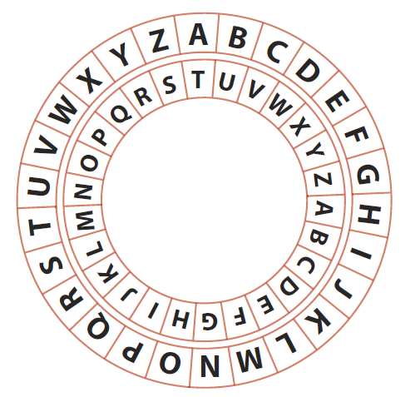
Figure 5.1 Any shift cipher can easily be encoded and decoded on a wheel of two pieces of paper with the alphabet set as a ring; by moving one circle the specified number in the shift, you can translate the characters.

Slide 20
Substitution Ciphers (continued)
Substitution ciphers arose due to the ease with which shift ciphers were broken.
Popular during the second half of the 16th century
Based on the principle of substituting a different letter for every letter
Examining cipher text for frequent letters is known as frequency analysis.
Can be applied to a substitution cipher to determine the system’s key value
Notes:
Substitution ciphers were popular in Elizabethan England (roughly the second half of the sixteenth century).
This system permits 26 possible values for every letter in the message, making the cipher many times more complex than a standard shift cipher.

Slide 21
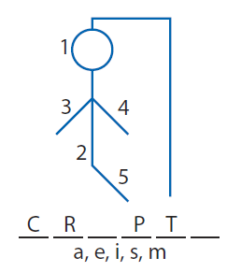
Figure 5.3 Making educated guesses is much like playing hangman—correct guesses can lead to more or all of the key being revealed.

Slide 22
Vigenère Cipher
The Vigenère cipher works as a polyalphabetic substitution cipher that depends on a password.
The process involves:
Creating a substitution table
Matching the password to the text it is meant to encipher with password repeated if needed to match all up with all plaintext characters
Determining the cipher letter by matching the plaintext charter’s row with the password character’s column – ciphertext character is the intersecting character

Slide 23

Example applying the Vigenère cipher:
Plaintext is Sample Message
Password is password Ciphertext is HAEHHSDHHSSYA
SAMPLEMESSAGE
PASSWORDPASSW
HAEHHSDHHSSYA
Substitution table

Slide 24
Vigenère Cipher (continued)
Characteristics of the Vigenère cipher system and systems like it:
The algorithms are rather simple.
The key is rather complex, with the best keys comprising very long and very random data.
There are systems to create cryptographic random numbers.
Level of complexity of the system is dependent upon the level of pure randomness needed.

Slide 25
One-Time Pad
Theoretically perfect and unbreakable
Key the same size or larger than the material being encrypted
Plaintext XOR’ed against the key to produce the ciphertext
“Perfect” characteristic due to the size of the key
Notes:
Security + Objective 6.2k One-time Pad
Note: One-time pads are examples of perfect ciphers from a mathematical point of view. But when put into practice, the implementation creates weaknesses that result in less than perfect security. This is an important reminder that perfect ciphers from a mathematical point of view do not create perfect security in practice because of the limitations associated with implementation.

Slide 26
Algorithms
Algorithm – a step-by-step, recursive computational procedure for solving a problem in a finite number of steps
Cryptographic algorithm—commonly called the encryption algorithm or cipher—mathematical steps for encrypting and decrypting information

Slide 27
Algorithms (continued)
Three types of commonly used encryption algorithms
Hashing takes an input and mathematically reduces it to a unique number known as a hash, which is not reversible.
Symmetric algorithms (or shared secret algorithms) use the same key is used for encryption and decryption.
Asymmetric algorithms employ employing two keys, a public key and a private key, making up what is known as a key pair.

Slide 28
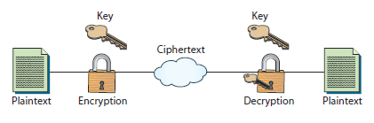
Encryption and decryption process

Slide 29
Algorithms (continued)
The best algorithms are always public algorithms.
They are peer reviewed by other cryptographic and mathematical experts.
Publication is important.
Any flaws in the system revealed by others before actual system used
A system that maintains its security after public testing can be reasonably trusted to be secure.
More secure due to reliance on the encryption key to provide security, not the algorithm itself
Notes:
Note: One of the most common cryptographic failures is the creation of your own encryption scheme. Rolling your own cryptography, whether in creating algorithms or implementation of existing algorithms yourself, is a recipe for failure. Always use approved algorithms and always use approved crypto libraries to implement.

Slide 30
Algorithms (continued)
A key is a special piece of data used in both the encryption and decryption processes
Algorithms the same in every implementation; a different key used in each situation
Most current algorithms are listed with their key size in bits.
Greater number of bits a more secure system
Notes:
Tech Tip: XOR
A popular function in cryptography is eXclusive OR (XOR), which is a bitwise function applied to data. When you apply a key to data using XOR, then a second application undoes the first operation. This makes for speedy encryption/decryption, but makes the system totally dependent upon the secrecy of the key. A hard-coded key in a program will be discovered, making this a weak security mechanism in most cases.
Tech Tip: Man-in-the-Middle Attack
A man-in-the-middle attack is designed to defeat proper key exchange by intercepting the remote party’s key and replacing it with the attacker’s key in both directions. If done properly, only the attacker knows that the encrypted traffic is not secure and the encrypted traffic can be read by the attacker.

Slide 31
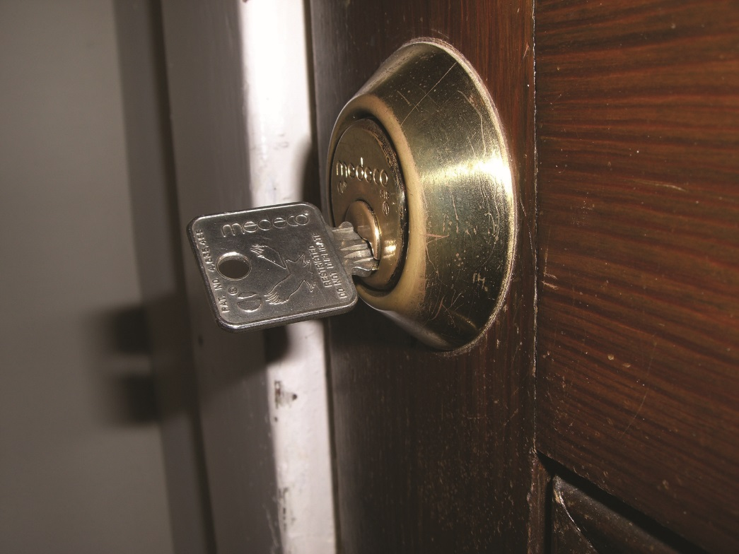
Figure 5.4 While everyone knows how to use a knob to open a door, without the key to unlock the knob, that knowledge is useless.

Slide 32
Key Management
Security of the algorithms relies on the key; key management is of critical concern.
Key management includes anything having to do with the exchange, storage, safeguarding, and revocation of keys.
Most commonly associated with asymmetric encryption
A key must be current and verified.
An old or compromised key requires a method to verify that the key has been revoked.

Slide 33
Key Management (continued)
Key storage critical to confidentiality of the encrypted information
Approaches to secure storage of keys
USB flash drive or smart card
Trusted Platform Module (TPM) – hardware-based key storage location
Notes:
Security + Objective 6.4 key management
Key management is also important for symmetric encryption, because symmetric encryption relies on both parties having the same key for the algorithm to work. Since these parties are usually physically separate, key management is critical to ensure keys are shared and exchanged easily. They must also be securely stored to provide appropriate confidentiality of the encrypted information. There are many different approaches to secure storage of keys, such as putting them on a USB flash drive or smart card. While keys can be stored in many different ways, new PC hardware often includes the Trusted Platform Module (TPM), which provides a hardware-based key storage location that is used by many applications.

Slide 34
Random Numbers
Software libraries have pseudo-random generators.
Series of numbers produced appear statistically random.
These generators are deterministic – inappropriate for use in cryptographic situations.
Entropy is the level or amount of randomness.
Perfect entropy equates to complete randomness.
The level of complexity of the system is dependent upon the level of pure randomness needed.
Notes:
Tech Tip: Randomness Issues
The importance of proper random number generation in cryptosystems cannot be underestimated. Recent reports by the Guardian and the New York Times assert that the U.S. National Security Agency (NSA) has put a backdoor into the Cryptographically Secure Random Number Generator (CSPRNG) algorithms described in NIST SP 800-90A, particularly the Dual_EC_DRBG algorithm. Further allegations are that the NSA paid RSA $10 million to use the resulting standard in its product line.

Slide 35
Module 4 Cryptography and Public Key Infrastructure – Part 2

Slide 36
Hashing Functions
Hashing functions are commonly used encryption methods.
A hashing function or hash function is a special mathematical function that performs a one-way function.
Once the algorithm is processed, there is no feasible way to use the ciphertext to retrieve the plaintext.
There is no feasible way to generate two different plaintexts that compute to the same hash value.

Slide 37
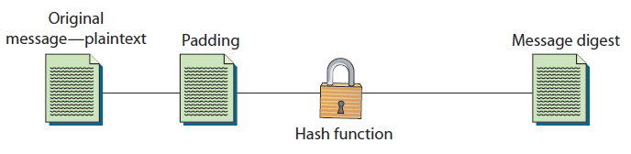
One-way nature of hashing functions

Slide 38
Hashing Functions (continued)
Hashing functions are used to:
Store computer passwords
Ensure message integrity
Hashing produces a unique value that corresponds to the data entered.
The hash value is also reproducible by anyone else running the same algorithm against the same data.

Slide 39
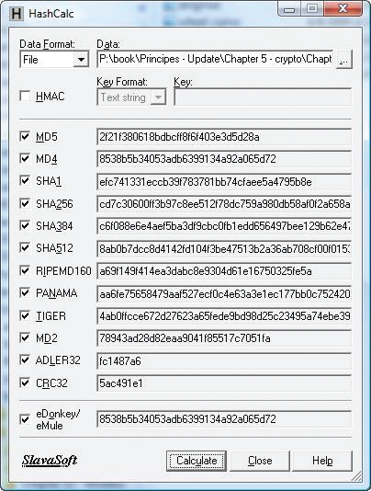
Figure 5.5 There are several programs available that will accept an input and produce a hash value, letting you independently verify the integrity of downloaded content.
Try https://hashcalc.soft112.com/

Slide 40
Collision Attack
A collision attack compromises a hash algorithm.
Occurs when an attacker finds two different messages that hash to the same value
Very difficult and requires generating a separate algorithm that attempts to find a text that will hash to the same value of a known hash
Must occur faster than a brute-force type attack
Hash functions suffering from collisions lose integrity; user can be tricked into running malicious code.

Slide 41
Popular Hash Algorithms
Secure Hash Algorithm (SHA) series
RIPEMD algorithms
Message Digest (MD) hash
MD2, MD4, MD5
Notes:
Tech Tip: Hashing Algorithms
The hashing algorithms in common use are MD2, MD4, and MD5, and SHA-1, SHA-256, SHA-384, and SHA-512. Because of potential collisions, MD2, MD4, MD5, and SHA-1 have been deprecated by many groups. Although not considered secure, they are still found in use, a testament to slow adoption of better security.
Tech Tip: Block Mode in Hashing
Most hash algorithms use block mode to process; that is, they process all input in set blocks of data such as 512-bit blocks. The final hash is typically generated by adding the output blocks together to form the final output string of 160 or 512 bits.

Slide 42
SHA
SHA stands for Secure Hash Algorithm.
A set of four hash algorithms published by the National Institute of Standards and Technology (NIST) and the National Security Agency (NSA)
Included in the SHA standard Federal Information Processing Standards (FIPS) 180-2 and 180-3
Notes:
Security + Objective 6.2c SHA
The individual standards are named SHA-1, SHA-224, SHA-256, SHA-384, and SHA-512. The latter three variants are occasionally referred to collectively as SHA-2. The newest version is known as SHA-3, which is specified in FIPS 202.

Slide 43
Individual Standards of SHA
SHA-1, SHA-256, SHA-384, SHA-512, SHA-3
SHA-1 was one of the more secure hash functions.
But it has been found to be vulnerable to a collision attack.
These longer versions are referred to as SHA-2.
SHA-256, SHA-384, and SHA-512 – all have longer hash results than SHA-1; more difficult to attack successfully
SHA-2 requires more processing power to compute the hash.
SHA-3 is the newest version – specified in FIPS 202.
Notes:
Security + Objective 6.2c SHA
SHA-1 works, as do all hashing functions, by applying a compression function to the data input. It accepts an input of up to 2⁶⁴ bits or less and then compresses down to a hash of 160 bits. SHA-1 works in block mode, separating the data into words first, and then grouping the words into blocks. The words are 32-bit strings converted to hex; grouped together as 16 words, they make up a 512-bit block. If the data that is input to SHA-1 is not a multiple of 512, the message is padded with zeros and an integer describing the original length of the message. Once the message has been formatted for processing, the actual hash can be generated. The 512-bit blocks are taken in order until the entire message has been processed.

Slide 44
RIPEMD
Acronym for RACE Integrity Primitives Evaluation Message Digest
Versions include original 128-bit hash; RIPEMD-160; RIPEMD-256; and RIPEMD-320
RIPEMD-160 an algorithm based on MD4 but uses two parallel channels with five rounds
Output consists of five 32-bit words to make a 160-bit hash
Notes:
The SHA-2 and SHA-3 series are currently approved for use. SHA-1 has been deprecated and its use discontinued in many strong cipher suites.
RIPEMD-160 is an algorithm based on MD4, but it uses two parallel channels with five rounds. The output consists of five 32-bit words to make a 160-bit hash. There are also larger output extensions of the RIPEMD-160 algorithm. These extensions, RIPEMD-256 and RIPEMD-320, offer outputs of 256 bits and 320 bits, respectively. While these offer larger output sizes, this does not make the hash function inherently stronger.

Slide 45
Message Digest
Message digest (MD) is the generic version of one of several algorithms designed to create a message digest or hash from data input into the algorithm.
MD algorithms work in the same manner as SHA.
A secure method employed to compress the file and generate a computed output of a specified number of bits.
The MD algorithms were all developed by Ronald L. Rivest of MIT.
MD2, MD4, MD5
Notes:
MD5 creates a 128-bit hash of a message of any length.
Tech Tip: Rainbow Tables
Rainbow tables are precomputed hash tables that enable looking up small text entries via their hash values. This makes hashed passwords “reversible” by looking up the hash in a precomputed hash table. This works for small passwords (less than 10 characters) and is very fast. Salting passwords is one of the defenses against these tables.

Slide 46
MD2
MD2 developed in 1989; an early version of MD5.
It takes a data of any length and produces a hash output of 128 bits.
MD2 optimized for 8-bit machines.
MD4, MD5 optimized for 32-bit machines.
Notes:
Security+ Objective 6.2b MD5

Slide 47
MD4
MD4 developed in 1990; optimized for 32-bit computers.
It is a fast algorithm, but it is subject to more attacks than more secure algorithms such as MD5.
It has been shown to be vulnerable to collision.
Most people use MD5 rather than MD4
Notes:
Security+ Objective 6.2b MD5
An extended version of MD4 computes the message in parallel and produces two 128-bit outputs—effectively a 256-bit hash.
Even though a longer hash is produced, security has not been improved because of basic flaws in the algorithm.
Cryptographer Hans Dobbertin has shown how collisions in MD4 can be found in under a minute using just a PC.
This vulnerability to collisions applies to 128-bit MD4 as well as 256-bit MD4.
Most people are moving away from MD4 to MD5 or a robust version of SHA.

Slide 48
MD5
Developed in 1991 and structured with additional security to overcome the problems in MD4
Very similar to the MD4 algorithm, only slightly slower and more secure
Creates a 128-bit hash of a message of any length and segments the message into 512-bit blocks
Notes:
Security + Objective 6.2b MD5
MD5 creates a 128-bit hash of a message of any length.

Slide 49
Hashing Summary
Hashing functions very common
Play an important role in security
Storing passwords
Signing messages
Maintaining message integrity
Primary purpose of hashing protocols
By computing a digest of the message, less data needs to be signed by the more complex asymmetric encryption

Slide 50
Symmetric Encryption
Symmetric encryption is an older and simpler method of encrypting information.
Both the sender and the receiver of the message have the same key.
All symmetric algorithms are based upon this shared secret principle.
A cryptographic key is involved in symmetric encryption, so there must be a mechanism for key management.
Popular algorithms are DES, 3DES, AES, and IDEA.
Notes:
Security + Objective 6.1a Symmetric Key
Having the same key is the basis for even the oldest ciphers—the Spartans needed the exact same size cylinder, making the cylinder the “key” to the message. In shift ciphers both parties need to know the direction and amount of shift being performed.
All symmetric algorithms are based upon this shared secret principle, including the unbreakable one-time pad method.

Slide 51
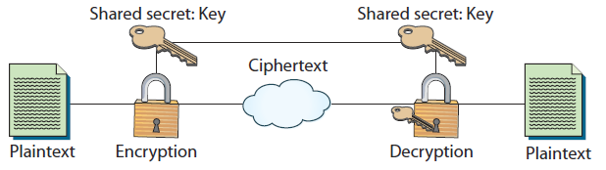
Figure 5.6 Layout of a symmetric algorithm
Notes:
This is a simple diagram showing the process that a symmetric algorithm goes through to provide encryption from plaintext to ciphertext.
This ciphertext message is transmitted to the message recipient, who goes through the process to decrypt the message using the same key that was used to encrypt the message.
The keys to the algorithm are the same value in symmetric encryption.

Slide 52
Data Encryption Standard (DES)
Developed in 1973; adopted as a federal standard in 1976
DES a block cipher
Block size of 64 bits—64 bits of plaintext outputs 64 bits of ciphertext.
56-bit key length
Performs a substitution and permutation (a form of transposition) based on the key 16 times on every 64-bit block.
Notes:
Security + Objective 6.2e AES
Security + Objective 6.2f DES
NBS (now called NIST) received an algorithm called Lucifer, originally developed by IBM.
The NBS and the NSA worked together to analyze the algorithm’s security, and eventually DES was adopted as a federal standard in 1976.
NBS specified that the DES standard had to be recertified every five years.
Passed without a hitch in 1983, not in 1987. Forced to recertify in 1993.
NIST has now certified the Advanced Encryption Standard (AES) to replace DES.
Over the years that DES has been a cryptographic standard, some problems have been encountered.
Weak keys are keys that are less secure than the majority of keys allowed in the keyspace of the algorithm.
In the case of DES, because of the way the initial key is modified to get the subkey, certain keys are weak keys.
The weak keys equate in binary to having all 1’s or all 0’s.
Semiweak keys, with which two keys will encrypt plaintext to identical ciphertext, also exist, meaning that either key will decrypt the ciphertext. The total number of possibly weak keys is 64, which is very small relative to the 2⁵⁶ possible keys in DES.

Slide 53
DES (continued)
Problems with DES
Weak keys – keys that are less secure than the majority of keys allowed in the keyspace of the algorithm
Semiweak keys – two keys that will encrypt plaintext to identical ciphertext
DES reasonably secure – has been for two decades
Notes:
Security + Objective 6.2e AES
Security + Objective 6.2f DES
NBS (now called NIST) received an algorithm called Lucifer, originally developed by IBM.
The NBS and the NSA worked together to analyze the algorithm’s security, and eventually DES was adopted as a federal standard in 1976.
NBS specified that the DES standard had to be recertified every five years.
Passed without a hitch in 1983, not in 1987. Forced to recertify in 1993.
NIST has now certified the Advanced Encryption Standard (AES) to replace DES.
Over the years that DES has been a cryptographic standard, some problems have been encountered.
Weak keys are keys that are less secure than the majority of keys allowed in the keyspace of the algorithm.
In the case of DES, because of the way the initial key is modified to get the subkey, certain keys are weak keys.
The weak keys equate in binary to having all 1’s or all 0’s.
Semiweak keys, with which two keys will encrypt plaintext to identical ciphertext, also exist, meaning that either key will decrypt the ciphertext. The total number of possibly weak keys is 64, which is very small relative to the 2⁵⁶ possible keys in DES.

Slide 54
3DES
Triple DES (3DES) is a variant of DES.
Depending on the variant, it uses either two or three keys.
Multiple encryption – goes through the DES algorithm three times.
3DES is stronger than DES but has similar weakness.
The longer key length makes it more resistant to brute force attacks.
3DES is still popular and widely supported
AES has taken over as the symmetric encryption standard
Notes:
Security + Objective 6.2g 3DES
Multiple encryption can be performed in several different ways.
The simplest method of multiple encryption is just to stack algorithms on top of each other.
—Taking plaintext, encrypting it with DES, then encrypting the first ciphertext with a different key, and finally encrypting the second ciphertext with a third key.
In reality, this technique is less effective than the technique that 3DES uses, which is to encrypt with one key, then decrypt with a second, and then encrypt with a third.
This greatly increases the number of attempts needed to retrieve the key and is a significant enhancement of security.
The additional security comes with a price, however. It can take up to three times longer to compute 3DES than to compute DES.
While this is the case, advances in memory and processing power in today’s electronics should make this problem irrelevant in all devices except for very small low-power handhelds.

Slide 55
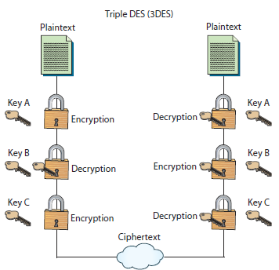
Figure 5.8 Diagram of 3DES

Slide 56
AES
The current gold standard for symmetric encryption
A block cipher that separates data input into 128-bit blocks
Can also be configured to use blocks of 192 or 256 bits.
Key sizes of 128, 192, and 256 bits
Key size affects the number of rounds used in the algorithm.
Longer key versions are known as AES-192 and AES-256, respectively.
No efficient attacks currently in existence
Notes:
Security + Objective 6.2e AES
Tech Tip: AES in Depth
For a more in-depth description of AES, see the NIST document http://csrc.nist.gov/publications/fips/fips197/fips-197.pdf.

Slide 57
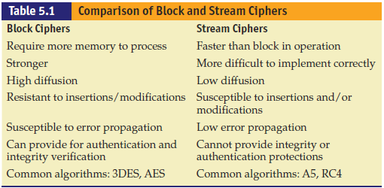
Block vs. Stream
Notes:
Security + Objective 6.2c SHA

Slide 58
Symmetric Encryption Summary
Importance of symmetric algorithms
Comparatively fast
Few computational requirements
Main weaknesses
Two geographically distant parties both need to have a key that matches the other key exactly.
Simple keys can quickly be brute-forced.
Secure key exchange can be an issue.

Slide 59
Asymmetric Encryption
Commonly known as public key cryptography.
Invented by Whitfield Diffie and Martin Hellman in 1975
Uses a pair of keys
A private key that is kept secret
A public key that can be sent to anyone
Security reliant upon resistance to deducing one key, given the other
Notes:
Security + Objective 6.1a Symmetric vs. asymmetric
Asymmetric encryption creates the possibility of digital signatures and also addresses the main weakness of symmetric cryptography. The ability to send messages securely without senders and receivers having had prior contact has become one of the basic concerns with secure communication. Digital signatures will enable faster and more efficient exchange of all kinds of documents, including legal documents. With strong algorithms and good key lengths, security can be assured.
Tip: Public key cryptography always involves two keys, a public key and a private key, which together are known as a key pair. The public key is made widely available to anyone who may need it, while the private key is closely safeguarded and shared with no one.

Slide 60
Asymmetric Encryption (continued)
Creates the possibility of digital signatures
Addresses the main weakness of symmetric cryptography
Involves two separate but mathematically related keys
Keys are used in opposing fashion – one key undoes the actions of the other and vice versa
Exchanges of keys via digital certificates

Slide 61
Asymmetric Encryption (continued)
System works by using hard math problems.
A common method relies on the difficulty of factoring large numbers.
Trapdoor functions are difficult to process without the key but easy to process when you have the key.
Computers can easily multiply very large primes with hundreds or thousands of digits but cannot easily factor the product.
Public key systems form the basis for digital signatures.
Notes:
For example, given a prime number, say 293, and another prime, such as 307, it is an easy function to multiply them together to get 89,951.
Given 89,951, it is not simple to find the factors 293 and 307 unless you know one of them already.
The strength of these functions is very important: Because an attacker is likely to have access to the public key, he can run tests of known plaintext and produce ciphertext.
This allows instant checking of guesses that are made about the keys of the algorithm.
Public key systems, because of their design, also form the basis for digital signatures, a cryptographic method for securely identifying people. RSA, Diffie-Hellman, elliptic curve cryptography (ECC), and ElGamal are all popular asymmetric protocols. We will look at all of them and their suitability for different functions.
Tip: Asymmetric methods are significantly slower than symmetric methods and thus are typically no

Slide 62
Diffie-Hellman (DH)
DH created in 1976 by Whitfield Diffie and Martin Hellman.
The protocol is one of the most common encryption protocols in use today.
DH is used for:
Electronic key exchange method of the Secure Sockets Layer (SSL) protocol
TLS, SSH, and IPsec protocols
Sharing of a secret key between two people who have not contacted each other before.
Notes:
Security + Objective 6.2u SSL/TLS
Uses large prime numbers to work. Two users agree to two numbers, P and G, with P being a sufficiently large prime number and G being the generator.
Both users pick a secret number, a and b.
Then both users compute their public number:
Diffie-Hellman is still in wide use. It remains very effective because of the nature of what it is protecting—a temporary, automatically generated secret key that is good only for a single communication session.
Tip: Diffie-Hellman is the gold standard for key exchange, and for the CompTIA Security+ exam, you should understand the subtle differences between the different forms, DH, EDH, ECDH, and ECDHE.

Slide 63
RSA
Ron Rivest, Adi Shamir, and Leonard Adleman (RSA)
One of the first public key cryptosystems invented
Published in 1997
Used for encryption and digital signatures
Uses the product of two very large prime numbers 100 to 200 digits long and of equal length
A simple algorithm that has withstood the test of more than 20 years of analysis
Notes:
Security + Objective 6.2i RSA
Considering the effectiveness of RSA’s security and the ability to have two keys, why are symmetric encryption algorithms needed at all?
The answer is speed. RSA in software can be 100 times slower than DES, and in hardware it can be even slower.
RSA can be used to perform both regular encryption and digital signatures. Digital signatures try to duplicate the functionality of a physical signature on a document using encryption. Typically, RSA and the other public key systems are used in conjunction with symmetric key cryptography. Public key, the slower protocol, is used to exchange the symmetric key (or shared secret), and then the communication uses the faster symmetric key protocol. This process is known as electronic key exchange.
Since the security of RSA is based upon the supposed difficulty of factoring large numbers, the main weaknesses are in the implementations of the protocol. Until recently, RSA was a patented algorithm, but it was a de facto standard for many years.

Slide 64
RSA (continued)
Does not replace symmetric encryption because RSA is 100 times slower than DES!
Asymmetric encryption used to exchange symmetric keys

Slide 65
ElGamal
Taher Elgamal designed the system in the early 1980s.
It can be used for both encryption and digital signatures.
This system was never patented and is free for use.
It is used as the U.S. government standard for digital signatures.
It is slower than symmetric cryptography.

Slide 66
Elliptic Curve Cryptography (ECC)
Works on the basis of elliptic curves
Elliptic curves are defined by this equation:
y² = x³ + ax² + b
Elliptic curves work because they have a special property—you can add two points on the curve together and get a third point on the curve.
Security in question due to lack of analysis.
Unless there is a breakthrough in math, ECC will continue to be a good algorithm.
Used in bitcoin for digital signature
Notes:
Security + Objective 6.1j ECC
The security of elliptic curve systems has been questioned, mostly because of lack of analysis.
However, all public key systems rely on the difficulty of certain math problems. It would take a breakthrough in math for any of the mentioned systems to be weakened dramatically, but research has been done about the problems and has shown that the elliptic curve problem has been more resistant to incremental advances. Again, as with all cryptography algorithms, only time will tell how secure they really are.

Slide 67
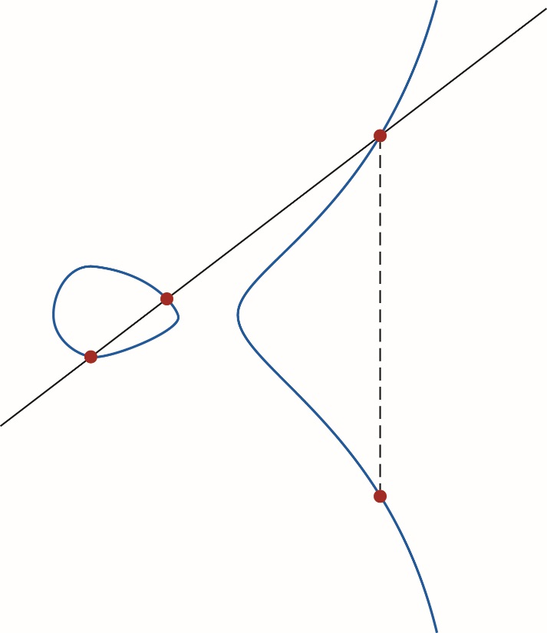
Elliptical Curve

Slide 68
Asymmetric Encryption Summary
Creates the possibility of digital signatures
Corrects the main weakness of symmetric cryptography.
Ability to send messages securely without senders and receivers having had prior contact.
Digital signatures enable faster and more efficient exchange of all kinds of documents.
With strong algorithms and good key lengths, security can be assured.

Slide 69
Symmetric vs. Asymmetric
Both have advantages and disadvantages
Symmetric encryption tends to be faster, is less computationally involved, and is better for bulk transfers.
Suffers from a key management problem in that keys must be protected from unauthorized parties
Asymmetric methods resolve the key secrecy issue with public keys,
Add significant computational complexity that makes them less suited for bulk encryption
Notes:
Bulk encryption can be done using the best of both systems, by using asymmetric encryption to pass a symmetric key. By adding in ephemeral key exchange, you can achieve perfect forward secrecy, discussed later in the chapter. Digital signatures, a highly useful tool, are not practical without asymmetric methods.

Slide 70
Quantum Cryptography
Quantum cryptography based on quantum mechanics, e.g., superposition and entanglement.
Principle of most concern in quantum mechanics is that the measuring of data disturbs the data.
Quantum key distribution applies quantum cryptography in determining whether data has been intercepted in transit.
Other fields include quantum cryptanalysis and post-quantum cryptography.

Slide 71
Steganography
Steganography is an offshoot of cryptography technology
Greek word steganos, meaning covered
Invisible ink, or tattoo, on head under hair
Commonly hiding text message in picture file
Detection is difficult.
Images do not attract attention.
Message can also be encrypted.
Notes:
Security + Objective 6.1g Steganography
The data that is hidden in a steganographic message is frequently also encrypted, so that if it is discovered, the message will remain secure.
Steganography has many uses but the most publicized uses are to hide illegal material, often pornography, or allegedly for covert communication by terrorist networks.
While there is no direct evidence to support that terrorists use steganography, the techniques have been documented in some of their training materials.
Steganographic encoding can be used in many ways and through many different media.
Some popular steganography detection tools include Stegdetect, StegSecret, StegSpy, and the family of SARC tools. All of these tools use detection techniques based upon the same principle, pattern detection. By looking for known steganographic encoding schemes or artifacts, they can potentially detect embedded data. Additionally steganography insertion tools can be used to attempt to decode images with suspected hidden messages. Invisible Ink is a small program for steganographic insertion of messages and then extraction of those messages, as illustrated here.

Slide 72
Steganography (continued)
Most publicized uses of steganography are to hide illegal material.
Pornography
Covert communication by terrorist networks
Popular steganography detection tools include :
Stegdetect
StegSecret
StegSpy
Family of SARC tools
Notes:
Security + Objective 6.1g Steganography
The nature of the image files also makes a hidden message difficult to detect. While it is most common to hide messages inside images, they can also be hidden in video and audio files.
The data that is hidden in a steganographic message is frequently also encrypted, so that if it is discovered, the message will remain secure.
Steganography has many uses but the most publicized uses are to hide illegal material, often pornography, or allegedly for covert communication by terrorist networks.
Some popular steganography detection tools include Stegdetect, StegSecret, StegSpy, and the family of SARC tools. All of these tools use detection techniques based upon the same principle, pattern detection. By looking for known steganographic encoding schemes or artifacts, they can potentially detect embedded data. Additionally steganography insertion tools can be used to attempt to decode images with suspected hidden messages. Invisible Ink is a small program for steganographic insertion of messages and then extraction of those messages, as illustrated here.

Slide 73
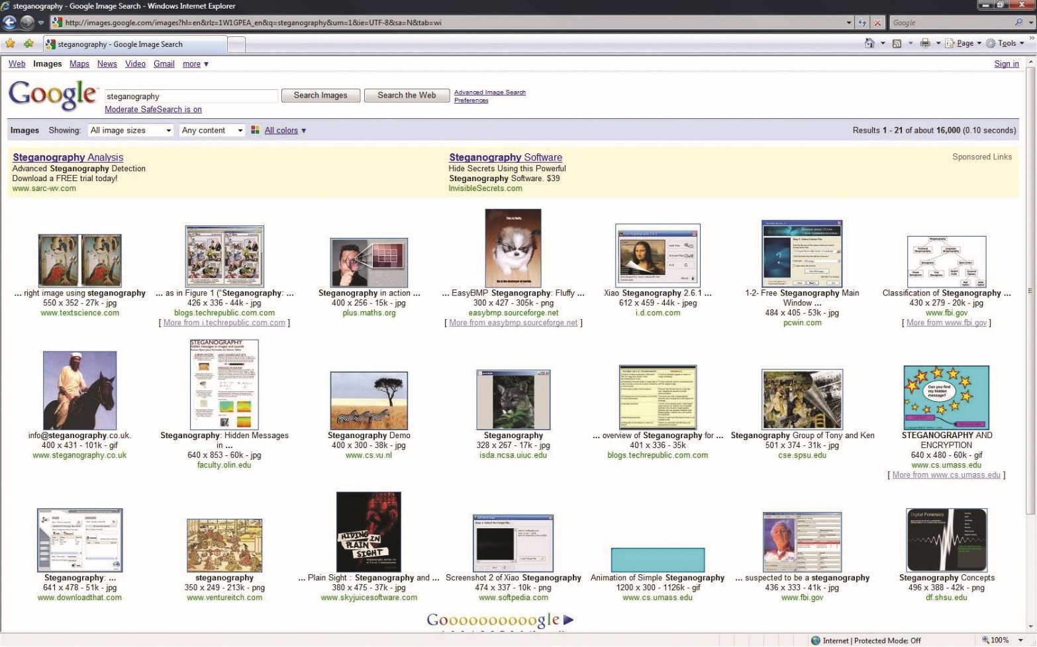
Googling Steganography

Slide 74
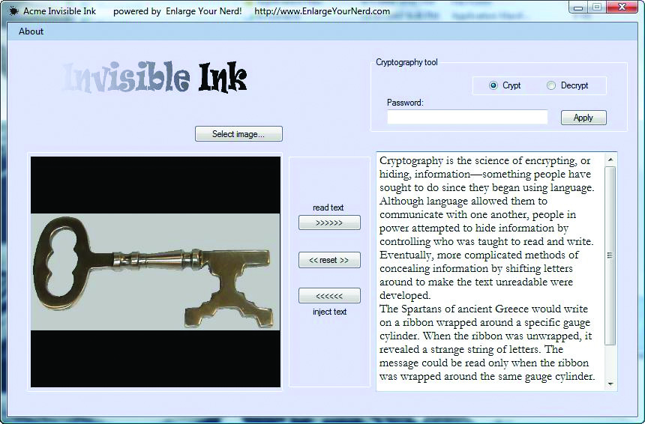

Slide 75
Cryptography Algorithm Use
The best way to secure data online with current technology is to use encryption.
The five components of security are:
Confidentiality, integrity, availability, authentication, and nonrepudiation
Encryption addresses all components except availability
Encryption algorithms play a key role in:
Key escrow; digital rights management and intellectual property protection; digital signatures

Slide 76
Confidentiality
Encryption excels at providing confidentiality.
In most cases, symmetric encryption is favored due to speed, and the increase of size when using asymmetric encryption.
Asymmetric cryptography is more efficient at protecting the confidentiality of small units, e.g. electronic key exchange
Secrecy of data is ensured by:
Strength of the algorithms
Length of the keys
Notes:
Security + Objective 2.8 Confidentiality
Confidentiality typically comes to mind when the term security is brought up. Confidentiality is the ability to keep some piece of data a secret. In the digital world, encryption excels at providing confidentiality. In most cases, symmetric encryption is favored because of its speed and because some asymmetric algorithms can significantly increase the size of the object being encrypted. Asymmetric cryptography also can be used to protect confidentiality, but its size and speed make it more efficient at protecting the confidentiality of small units for tasks such as electronic key exchange. In all cases, the strength of the algorithms and the length of the keys ensure the secrecy of the data in question.

Slide 77
Integrity
When a message is sent, both the sender and recipient need to know that the message was not altered in transmission.
Especially important for legal contracts.
The ability to independently make sure that a document has not been tampered with is very important to commerce.
The hash functions compute the message digests, and this guarantees the integrity of the message.
Notes:
Security + Objective 2.8 Integrity and Availability
Integrity, better known as message integrity, is a crucial component of message security. When a message is sent, both the sender and recipient need to know that the message was not altered in transmission. This is especially important for legal contracts—recipients need to know that the contracts have not been altered. Signers also need a way to validate that a contract they sign will not be altered in the future.
Note: Message integrity will become increasingly important as more commerce is conducted digitally. The ability to independently make sure that a document has not been tampered with is very important to commerce. More importantly, once the document is “signed” with a digital signature, it cannot be refuted that the person in question signed it.
Integrity is provided with one-way hash functions and digital signatures. The hash functions compute the message digests, and this guarantees the integrity of the message by allowing easy testing to determine whether any part of the message has been changed. The message now has a computed function (the hash value) to tell the users to resend the message if it was intercepted and interfered with.

Slide 78
Authentication
Authentication is the matching of a user to an account through previously shared credentials.
A combination of cryptographic methods are commonly employed in authentication.
From hashing to key stretching to encryption and digital signatures, multiple techniques are used as part of the operations involved in authentication

Slide 79
Nonrepudiation
The message sender cannot later deny that they sent the message.
This is important in electronic exchanges of data, because of the lack of face-to-face meetings.
Nonrepudiation is tied to asymmetric cryptography and cannot be implemented with symmetric algorithms.
Notes:
Security + Objective 6.1d Non-repudiation
An item of some confusion, the concept of nonrepudiation is actually fairly simple. Nonrepudiation means that the message sender cannot later deny that they sent the message. This is important in electronic exchanges of data, because of the lack of face-to-face meetings. Nonrepudiation is based upon public key cryptography and the principle of only you knowing your private key. The presence of a message signed by you, using your private key, which nobody else should know, is an example of nonrepudiation. When a third party can check your signature using your public key, that disproves any claim that you were not the one who actually sent the message. Nonrepudiation is tied to asymmetric cryptography and cannot be implemented with symmetric algorithms.
Tech Tip: HOTP
An HMAC-based One-Time Password (HOTP) algorithm is a key component of the Open Authentication Initiative (OATH). YubiKey is a hardware implementation of HOTP that has significant use.

Slide 80
Cipher Suites
In many applications, the use of cryptography occurs as a collection of functions.
Different algorithms can be used for authentication, encryption/decryption, digital signatures, and hashing.
Cipher suite refers to an arranged group of algorithms
TLS Cipher Suite Registry
Over time, ciphers can become vulnerable to attacks.
Choose and apply a cipher carefully

Slide 81
Key Exchange
Key exchange is the central foundational element of a secure symmetric encryption system.
In asymmetric systems, the key exchange problem is one of key publication.
The Diffie-Hellman key exchange is one example of secure key exchange via digital methods and mathematical algorithms.

Slide 82
Key Escrow
The loss of a key can happen due to many reasons:
It might simply be lost; the key holder might be incapacitated or dead; the software or hardware might fail.
Key escrow refers to keeping a copy of the encryption key with a trusted third party.
Can be used to retrieve your key in case of emergency
Can be used by law enforcement
Can negatively affect your security
Notes:
In many cases, that information is locked up until the cryptography can be broken, and as you have read, that could be millennia. This has raised the topic of key escrow, or keeping a copy of the encryption key with a trusted third party.
Theoretically, this third party would only release your key to you or your official designate on the event of your being unable to get the key yourself.
However, just as the old saying from Benjamin Franklin goes, “Three may keep a secret if two of them are dead.” Anytime more than one copy of the key exists, the security of the system is broken. The extent of the insecurity of key escrow is a subject open to debate, and will be hotly contest in the years to come.
Additionally, with computer technology being miniaturized into smartphones and other relatively inexpensive devices, criminals and other ill-willed people have begun using cryptography to conceal communications and business dealings from law enforcement agencies. Because law enforcement agencies have not been able to break the encryption in many cases, government agencies have begun asking for mandatory key escrow legislation.

Slide 83
Session Keys
A session key is a symmetric key used for encrypting messages during a communication session.
Generated from random seeds
Used for the duration of a communication session
Session keys offer the advantages of:
Symmetric encryption, speed, strength, simplicity
Significant levels of automated security

Slide 84
Ephemeral Keys
Ephemeral keys are cryptographic keys that are used only once after they are generated.
Examples of applications are:
Ephemeral Diffie-Hellman (EDH) key exchange
Elliptic Curve Diffie-Hellman Ephemeral (ECDHE)

Slide 85
Key Stretching
Key stretching is a mechanism that takes what would be weak keys and “stretches” them to make the system more secure against brute-force attacks.
A typical methodology involves increasing the computational complexity by adding iterative rounds of computations
Common forms employed today are:
Password-Based Key Derivation Function 2
Bcrypt

Slide 86
Secrecy Principles
Confusion is a principle to affect the randomness of an output.
Diffusion is a principle that the statistical analysis of plaintext and ciphertext results in a form of dispersion rendering one structurally independent of the other.
Perfect forward secrecy is a property of a public key system in which a key derived from another key is not compromised even if the originating key is compromised in the future.

Slide 87
Transport Encryption
Transport encryption is used to protect data that is in motion.
When data is being transported across a network, it is at risk of interception.
When utilizing the TCP/IP protocol, TLS is the preferred method of managing the security at the transport level.

Slide 88
Digital Signatures
Touted as the key to truly paperless document flow.
Digital signatures are based on both hashing functions and asymmetric cryptography.
Both encryption methods play an important role in signing digital documents.
Notes:
Security + Objective 6.1h Digital Signatures
Unprotected digital documents are very easy for anyone to change.
If a document is edited after an individual signs it, it is important that any modification can be detected.
To protect against document editing, hashing functions are used to create a digest of the message that is unique and easily reproducible by both parties. This ensures that the message integrity is complete.
The properties of asymmetric encryption allow anyone to use a person’s public key to generate a message that can be read only by that person, as this person is theoretically the only one with access to the private key. In the case of digital signatures, this process works exactly in reverse. When a user can decrypt the hash with the public key of the originator, that user knows that the hash was encrypted by the corresponding private key. This use of asymmetric encryption is a good example of nonrepudiation, because only the signer would have access to the private key. This is how digital signatures work, by using integrity and nonrepudiation to prove not only that the right person signed the digital document, but also that the digital document was not altered after being signed.

Slide 89
Digital Rights Management (DRM)
DRM is the process for protecting intellectual property from unauthorized use.
A common example of DRM is the broadcast stream of digital satellite TV.
DRM will also become very important in the industry of Software as a Service (SaaS).
Another example is hardware token USB keys that must be inserted into the machine for the software to decrypt and run.
Notes:
This is a broad area, but the most concentrated focus is on preventing piracy of software or digital content.
Before easy access to computers, or the “digital revolution,” the content we came in contact with was analog or print based
A common example of DRM that is mostly successful is the broadcast stream of digital satellite TV.
Since the signal is beamed from space to every home in North America, the satellite TV provider must be able to protect the signal so that it can charge people to receive it.
Smartcards are employed to securely hold the decryption keys that allow access to some or all of the content in the stream.
This system has been cracked several times, allowing a subset of users free access to the content; however, the satellite TV providers learned from their early mistakes and upgraded new smartcards to correct the old problems.
Similar to companies that provide satellite TV service, companies that provide SaaS rely on a subscription basis for profitability.
If someone could pay for a single license and then distribute that to hundreds of employees, the provider would soon go out of business.
Many systems in the past have been cracked because the key was housed inside the software.
Another example is hardware token USB keys that must be inserted into the machine for the software to decrypt and run.
Placing the keys in hardware makes an attack to retrieve them much harder, a concept that is employed in the Trusted Platform Module; in fact, one of the primary complaints against the TPM is its ability to enforce DRM restrictions.

Slide 90
Cryptographic Applications
A few applications can be used to encrypt data conveniently on your personal computer.
Pretty Good Privacy (PGP)
TrueCrypt is an open source solution for encryption.
FreeOTFE offers “on-the-fly” disk encryption as an open source.
GnuPG, or Gnu Privacy Guard, is an open source implementation of the OpenPGP standard.
BitLocker is a boot-sector encryption method that protects data on the Windows Vista operating system.
Notes:
Security+ Objective 6.2q PGP
Pretty Good Privacy (PGP) is mentioned in this book because it is a useful protocol suite. Created by Philip Zimmermann in 1991, it passed through several versions that were available for free under a noncommercial license.
PGP applications can be plugged into popular e-mail programs to handle the majority of day-to-day encryption tasks using a combination of symmetric and asymmetric encryption protocols.
One of the unique features of PGP is its ability to use both symmetric and asymmetric encryption methods, accessing the strengths of each method and avoiding the weaknesses of each as well. Symmetric keys are used for bulk encryption, taking advantage of the speed and efficiency of symmetric encryption. The symmetric keys are passed using asymmetric methods, capitalizing on the flexibility of this method. PGP is now sold as a commercial application, with home and corporate versions. Depending on the version, PGP can perform file encryption, whole disk encryption, and public key encryption to protect e-mail.
Begin Cross Check Sidebar
TrueCrypt is an open source solution for encryption. It is designed for symmetric disk-based encryption of your files. It features AES ciphers and the ability to create a deniable volume, encryption stored within encryption so that volume cannot be reliably detected. TrueCrypt can perform file encryption and whole disk encryption. Whole disk encryption encrypts the entire hard drive of a computer, including the operating system.
FreeOTFE is similar to TrueCrypt. It offers “on-the-fly” disk encryption as an open source, freely downloadable application. It can encrypt files up to entire disks with several popular ciphers, including AES.
GnuPG, or Gnu Privacy Guard, is an open source implementation of the OpenPGP standard. This command line–based tool is a public key encryption program designed to protect electronic communications such as e-mail. It operates similarly to PGP and includes a method for managing public/private keys.
Security+ Objective 6.2r Whole Disk Encryption
File system encryption is becoming a standard means of protecting data while in storage.
Even hard drives are available with built-in AES encryption. Microsoft expanded its Encrypting File System (EFS), available since the Windows 2000 operating system, with BitLocker, a boot-sector encryption method that protects data on the Windows Vista operating system. BitLocker is also used in Windows Server 2008 as well as the forthcoming Windows 7 operating system. BitLocker utilizes AES encryption to encrypt every file on the hard drive automatically. All encryption occurs in the background, and decryption occurs seamlessly when data is requested. The decryption key can be stored in the TPM or on a USB key.

Slide 91
Use of Proven Technologies
It is important to use proven technologies when setting up a cryptographic scheme.
Foundational elements associated with a solid program are:
Proven cryptographic libraries
Proven cryptographically correct random number generators
Most good algorithms are approved for use only after a lengthy test and public review phase.

Slide 92
Module 4 Cryptography and Public Key Infrastructure – Part 3

Slide 93

Public Key Infrastructure (PKI)
Chapter 6

Slide 94
Key Terms
Authority revocation list (ARL)
CA certificate
Certificate
Certificate authority (CA)
Certificate path
Certificate repository
Certificate revocation list (CRL)
Certificate server
Certificate signing request (CSR)
Certification practices statement (CPS)
Cross-certification certificate
Notes:
Authority revocation list (ARL) – A list of authorities that have had their certificates revoked.
CA certificate – A digital certificate identifying the keys used by a certificate authority.
Certificate – A cryptographically signed object that contains an identity and a public key associated with this identity. The certificate can be used to establish identity, analogous to a notarized written document.
Certificate authority (CA) – An entity responsible for issuing and revoking certificates. CAs are typically not associated with the company requiring the certificate, although they exist for internal company use as well (such as Microsoft). This term also applies to server software that provides these services. The term certificate authority is used interchangeably with certification authority.
Certificate path – An enumeration of the chain of trust from one certificate to another tracing back to a trusted root.
Certificate repository – A storage location for certificates on a system so that they can be reused.
Certificate revocation list (CRL) – A digitally signed object that lists all of the current but revoked certificates issued by a given certification authority. This allows users to verify whether a certificate is currently valid even if it has not expired. A CRL is analogous to a list of stolen charge card numbers that allows stores to reject bad credit cards.
Certificate server – A server–part of a PKI system–that handles digital certificates.
Certificate signing request (CSR) – A structured message sent to a certificate authority requesting a digital certificate.
Certification practices statement (CPS) – A document that describes the policy for issuing digital certificates from a CA.
Cross-certification certificate – A certificate used to establish trust between separate PKIs.

Slide 95
Key Terms (continued)
Digital certificate
Dual control
End-entity certificate
Hardware security module (HSM)
Hierarchical trust model
Hybrid trust model
Key archiving
Key escrow
Key recovery
Local registration authority (LRA)
Online Certificate Status Protocol (OCSP)
Peer-to-peer trust model
Notes:
Digital certificate – See certificate.
Dual control – Term that means that two people have to be present to carry out a specific task.
End-entity certificate – Certificates issued by a CA to a specific subject.
Hardware security module (HSM) – A physical device used to protect but still allow use of cryptographic keys. It is separate from the host machine.
Hierarchical trust model – A trust model that has levels or tiers of an ascending nature.
Hybrid trust mode – A combination of trust models including mesh, hierarchical, and network.
Key archiving – The processes and procedures to make a secure backup of cryptographic keys.
Key escrow – The process of placing a copy of cryptographic keys with a trusted third party for backup purposes.
Key recovery – A process by where lost keys can be recovered from a stored secret.
Local registration authority (LRA) – A Registration Authority (RA) that is part of a local unit or enterprise. It is typically only useful within the Enterprise, but in many cases this can be sufficient.
Online Certificate Status Protocol (OCSP) – A protocol used to request the revocation status of a digital certificate. This is an alternative to certificate revocation lists.
Peer-to-peer trust model – A trust model built upon actual peer-to-peer connection and communication to establish trust.

Slide 96
Key Terms (continued)
Policy certificate
Public key infrastructure (PKI)
Registration authority (RA)
Notes:
Policy certificate – Certificates that are used for high-security applications where a mechanism is required to provide centrally controlled policy information to PKI clients.
Public key infrastructure (PKI) – Infrastructure for binding a public key to a known user through a trusted intermediary, typically a certificate authority.
Registration authority (RA) – The party in the PKI process that establishes identity for the Certificate Authority to issue a certificate.

Slide 97
The Basics of Public Key Infrastructures
A public key infrastructure (PKI) provides all the components necessary for different types of users and entities to be able to communicate securely and in a predictable manner.
It consists of hardware, applications, policies, services, programming interfaces, cryptographic algorithms, protocols, users, and utilities.
Components work together to allow communication to take place using public key cryptography and symmetric keys for digital signatures, data encryption, and integrity.

Slide 98
The Basics of Public Key Infrastructures (continued)
Constructing and implementing a PKI boils down to establishing a level of trust.
In PKI environments, entities called registration authorities (RAs) and certificate authorities (CAs) provide services similar to those of the Department of Motor Vehicles (DMV).
Notes:
PKI works like the DMV
Certificate authorities (CAs) provide services similar to those of the Department of Motor Vehicles (DMV). When John goes to register for a driver’s license, he has to prove his identity to the DMV by providing his passport, birth certificate, or other identification documentation. If the DMV is satisfied with the proof John provides (and John passes a driving test), the DMV will create a driver’s license that can then be used by John to prove his identity. Whenever John needs to identify himself, he can show his driver’s license. Although many people may not trust John to identify himself truthfully, they do trust the third party, the DMV.

Slide 99
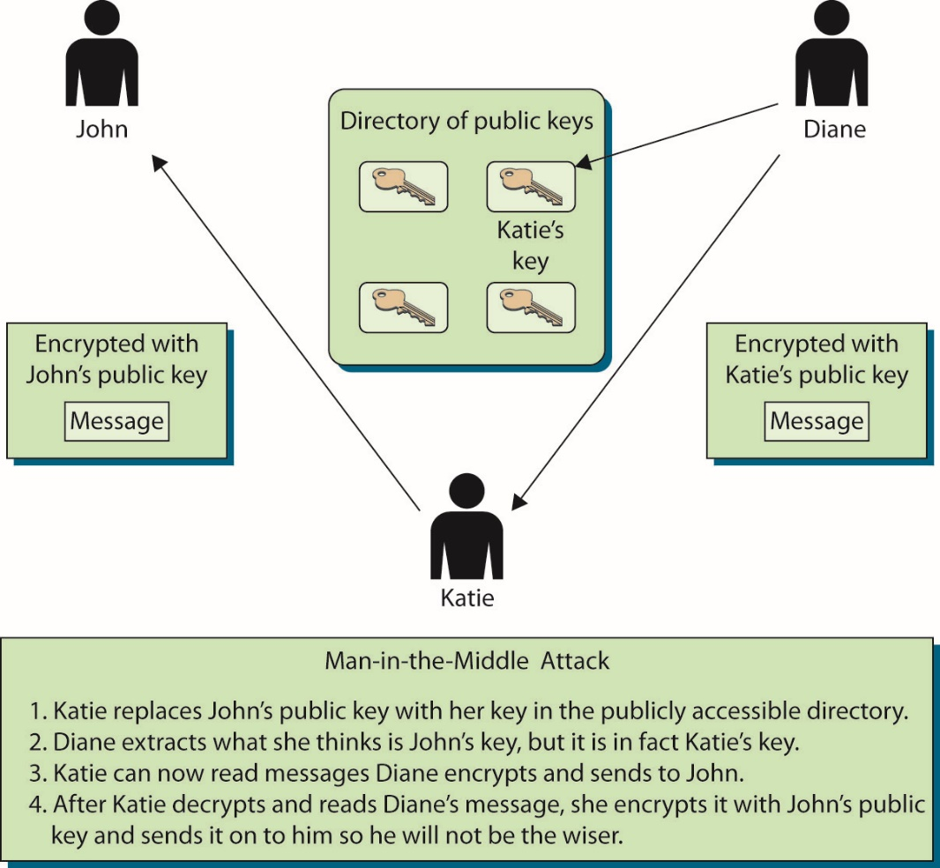
Figure 6.1 Without PKIs, individuals could spoof others’ identities.
Notes:
Implementing a PKI boils down to establishing a level of trust.
If John and Diane want to communicate securely, John can generate his own public/private key pair and send his public key to Diane, or he can place his public key in a directory that is available to everyone. If Diane receives John’s public key, either from him or from a public directory, how does she know the key really came from John? Maybe another individual, Katie, is masquerading as John and has replaced John’s public key with her own, as shown in Figure 6.1 (referred to as a man-in-the-middle attack).
If this took place, Diane would believe that her messages could be read only by John and that the replies were actually from him. However, she would actually be communicating with Katie. What is needed is a way to verify an individual’s identity, to ensure that a person’s public key is bound to their identity and thus ensure that the previous scenario (and others) cannot take place.

Slide 100
The Basics of Public Key Infrastructures (continued)
Third-party trust model
RA requires proof of identity from the individual requesting a certificate and will validate this information.
RA advises the CA to generate a certificate.
CA digitally signs the certificate using its private key.
The use of the CA’s private key ensures that the certificate came from the CA.
Notes:
When Diane receives John’s certificate and verifies that it was actually digitally signed by a CA that she trusts, she will believe that the certificate is actually John’s - not because she trusts John, but because she trusts the entity that is vouching for his identity (the CA).
Public keys are components of digital certificates, so when Diane verifies the CA’s digital signature, this verifies that the certificate is truly John’s and that the public key the certificate contains is also John’s. This is how John’s identity is bound to his public key. This process allows John to authenticate himself to Diane and others. Using the third-party certificate, John can communicate with Diane, using public key encryption, without prior communication or a preexisting relationship.

Slide 101
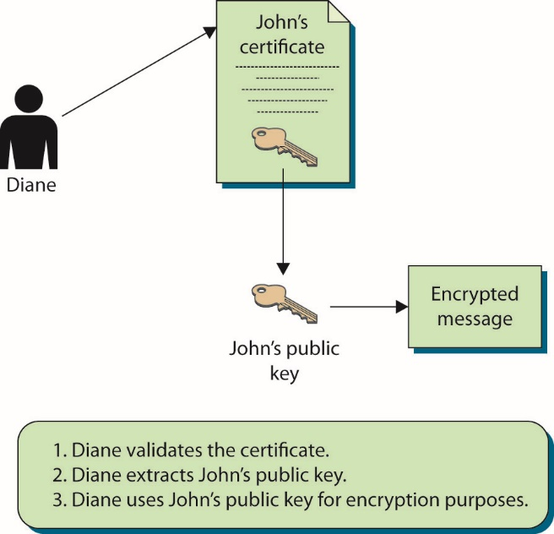
Figure 6.2 Public keys are components of digital certificates.
Notes:
Once Diane is convinced of the legitimacy of John’s public key, she can use it to encrypt messages between herself and John.

Slide 102
The Basics of Public Key Infrastructures (continued)
Numerous applications and protocols generate public/private key pairs and provide functionality similar to what a PKI provides.
No trusted third party is available for both communicating parties.
For each party to communicate without a third party vouching for the other’s identity, they must choose to trust each other and the communication channel.
PKI components provide the necessary level of trust you cannot, or choose not to, provide on your own.

Slide 103
The Basics of Public Key Infrastructures (continued)
An infrastructure provides a sustaining groundwork upon which other things can be built.
It works at a low level to provide a predictable and uniform environment that allows other, higher-level technologies to work together through uniform access points.
The environment the infrastructure provides allows higher-level applications to communicate with each other and gives them the underlying tools to carry out their tasks.

Slide 104
Certificate Authorities
A certificate authority (CA) is a trusted authority that certifies individuals’ identities and creates electronic documents indicating that individuals are who they say they are.
The electronic document is referred to as a digital certificate, and it establishes an association between the subject’s identity and a public key.
The private key that is paired with the public key in the certificate is stored separately.

Slide 105
Certificate Authorities (continued)
If one CA component is compromised, it can negatively affect the CA integrity overall.
Every CA should have a certification practices statement (CPS).
It outlines how identities are verified; the steps the CA follows to generate, maintain, and transmit certificates; and why the CA can be trusted to fulfill its responsibilities.
A certificate server is the actual service that issues certificates based on the data provided during the initial registration process.
Notes:
The CPS describes how keys are secured, what data is placed within a digital certificate, and how revocations will be handled. If a company is going to use and depend on a public CA, the company’s security officers, administrators, and legal department should review the CA’s entire CPS to ensure that it will properly meet the company’s needs, and to make sure that the level of security claimed by the CA is high enough for their use and environment. A critical aspect of a PKI is the trust between the users and the CA, so the CPS should be reviewed and understood to ensure that this level of trust is warranted.

Slide 106
Registration Authorities
A registration authority (RA) is the PKI component that accepts a request for a digital certificate and performs the necessary steps of registering and authenticating the person requesting the certificate.
The authentication requirements differ depending on the type of certificate being requested.
Most CAs offer a series of classes of certificates with increasing trust by class.
Notes:
Exam Tip: The RA verifies the identity of the certificate requestor on behalf of the CA. The CA generates the certificate using information forwarded by the RA.
Certificate Classes The types of certificates available can vary between different CAs, but usually at least three different types are available, and they are referred to as classes:
Class 1 A Class 1 certificate is usually used to verify an individual’s identity through e-mail. A person who receives a Class 1 certificate can use his public/private key pair to digitally sign e-mail and encrypt message contents.
Class 2 A Class 2 certificate can be used for software signing. A software vendor would register for this type of certificate so that it could digitally sign its software. This provides integrity for the software after it is developed and released, and it allows the receiver of the software to verify from where the software actually came.
Class 3 A Class 3 certificate can be used by a company to set up its own CA, which will allow it to carry out its own identification verification and generate certificates internally.

Slide 107
Registration Authorities (continued)
Each higher class of certificate can carry out more powerful and critical tasks than the one below it.
A 1:1 correspondence does not necessarily exist between identities and certificates.
If an application creates a key store that can be accessed by other applications, it will provide a standardized interface, called the application programming interface (API).
Often, the digital certificate and public key are also stored in a certificate repository.

Slide 108
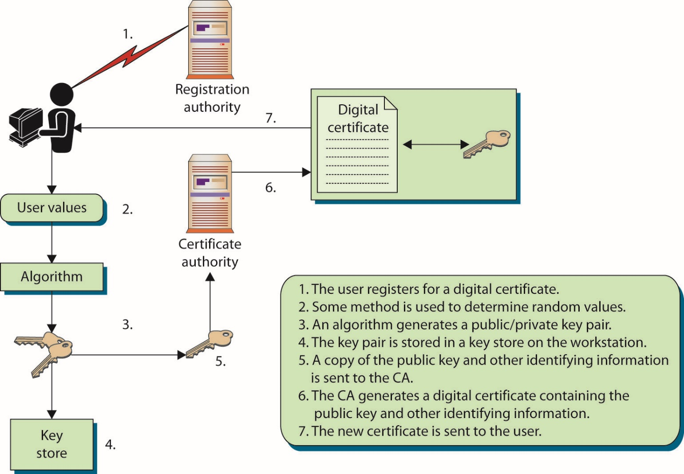
Figure 6.3 Steps for obtaining a digital certificate
Notes:
In most situations, when a user requests a Class 1 certificate, the registration process will require the user to enter specific information into a web-based form. The web page will have a section that accepts the user’s public key, or it will step the user through creating a public/private key pair, which will allow the user to choose the size of the keys to be created.
Once these steps have been completed, the public key is attached to the certificate registration form and both are forwarded to the RA for processing. The RA is responsible only for the registration process and cannot actually generate a certificate.
Once the RA is finished processing the request and verifying the individual’s identity, the RA sends the request to the CA. The CA uses the RA-provided information to generate a digital certificate, integrates the necessary data into the certificate fields (user identification information, public key, validity dates, proper use for the key and certificate, and so on), and sends a copy of the certificate to the user.
The certificate may also be posted to a publicly accessible directory so that others can access it.

Slide 109
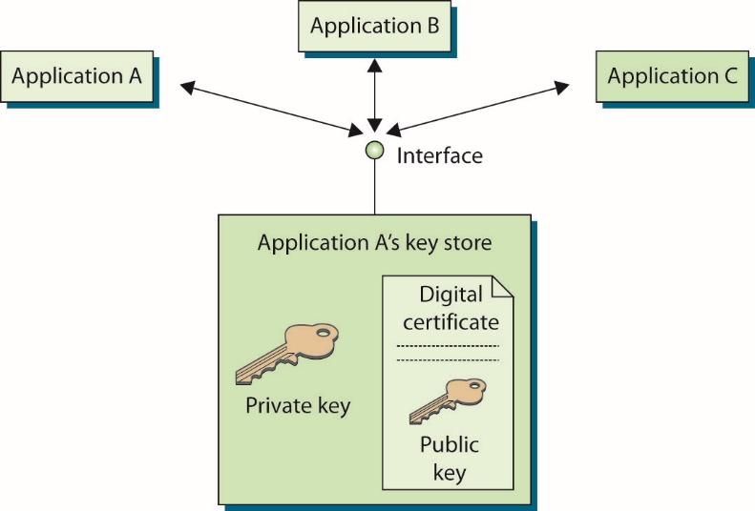
Figure 6.4 Some key stores can be shared by different applications.
Notes:
If an application creates a key store that can be accessed by other applications, it will provide a standardized interface, called the application programming interface (API). As an example, Figure 6.4 shows that application A went through the process of registering a certificate and generating a key pair. It created a key store that provides an interface to allow other applications to communicate with it and use the items held within the store.

Slide 110
Local Registration Authorities
A local registration authority (LRA) performs the same functions as an RA.
It is closer to the end users and reduces WAN traffic.
It is implemented in companies with their own internal PKIs and in companies with distributed sites
It performs identification, verification, registration functions; sends request, along with the user’s public key, to a centralized CA so that the certificate can be generated.
It acts as an interface between the users and the CA.
LRAs simplify the RA/CA process for entities that desire certificates only for in-house use.
Notes:
Exam Tip: The RA verifies the identity of the certificate requestor on behalf of the CA. The CA generates the certificate using information forwarded by the RA.

Slide 111
Digital Certificates
A digital certificate binds an individual’s identity to a public key.
It contains information a receiver needs to be assured of the identity of the public key owner.
It is created and formatted based on the X.509 standard.
Outlines necessary fields of a certificate and the possible values that can be inserted into the fields
Most current version: X.509 version 3, a standard of the International Telecommunication Union (http://www.itu.int)
Notes:
The subject of a certificate is commonly a person, but it does not have to be. The subject can also be a network device (router, web server, firewall, and so on), an application, a department, or a company. Each has its own identity that needs to be verified and proven to another entity before secure, trusted communication can be initiated. If a network device is using a certificate for authentication, the certificate may contain the identity of that device. This allows a user of the device to verify its authenticity based on the signed certificate and trust in the signing authority. This trust can be transferred to the identity of the device indicating authenticity.

Slide 112
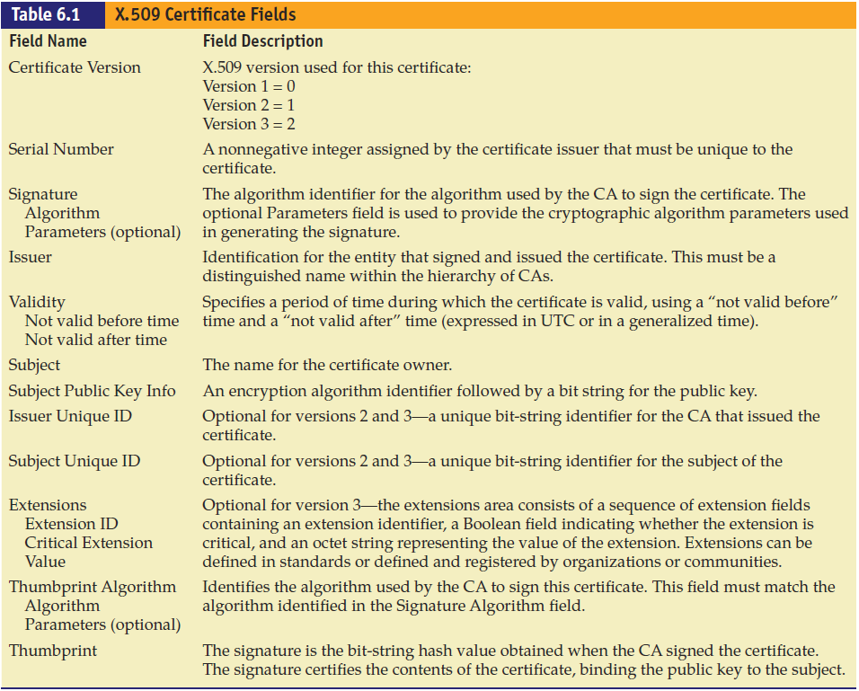
Notes:
Table 6.1 lists and describes the fields in an X.509 certificate.

Slide 113
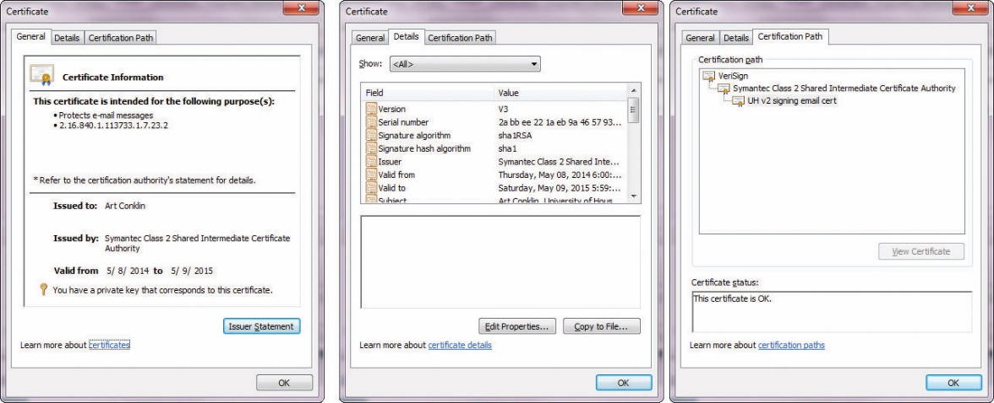
Figure 6.5 Fields within a digital certificate
Notes:
Figure 6.5 shows the actual values of the different certificate fields for a particular certificate in Internet Explorer. The version of this certificate is V3 (X.509 v3) and the serial number is also listed—this number is unique for each certificate that is created by a specific CA. The CA used the MD5 hashing algorithm to create the message digest value and then signed it using the CA’s private key using the RSA algorithm. The actual CA that issued the certificate is Root SGC Authority, and the valid dates indicate how long this certificate is valid. The subject is MS SGC Authority, which is the entity that registered this certificate and that is bound to the embedded public key. The actual public key is shown in the lower window and is represented in hexadecimal.

Slide 114
Certificate Extensions
Certificate extensions allow for further information to be inserted within the certificate.
Extensions provide more functionality in a PKI implementation.
Standard certificate extensions are implemented for every PKI implementation.
Private certificate extensions are defined for specific organizations (or domains within one organization), and they allow companies to further define different, specific uses for digital certificates to best fit their business needs.

Slide 115
Certificate Extensions (continued)
Key usage extensions dictate how the public key that is held within the certificate can be used.
Public keys are used for different functions:
Symmetric key encryption, data encryption, verifying digital signatures, and more.
Nonrepudiation service can be provided by third-party notary.
A trusted time source can be a trusted third party called a time stamp authority (TSA).
Gives users a higher level of confidence as to when specific messages were digitally signed.

Slide 116
Certificate Extensions (continued)
Critical and noncritical extensions are indicated by a specific flag within the certificate itself.
Flag set to critical indicates that the extension must be understood and processed by the receiver.
If flag set to noncritical, the certificate can be used for the intended purpose, even if the receiver does not process the appended extension.
Notes:
If the receiver is not configured to understand a particular extension marked as critical, and thus cannot process it properly, the certificate cannot be used for its proposed purpose.

Slide 117
Certificate Attributes
Four main certificate types
End-entity certificates – issued by a CA to a specific subject
CA certificates – self-signed, in the case of a standalone or root CA, or issued by a superior CA within a hierarchical model
Cross-certification certificates (cross certificate) – used when independent CAs establish peer-to-peer trust relationships
Policy certificates – used for high-security applications where a mechanism is required to provide centrally controlled policy information to PKI clients

Slide 118
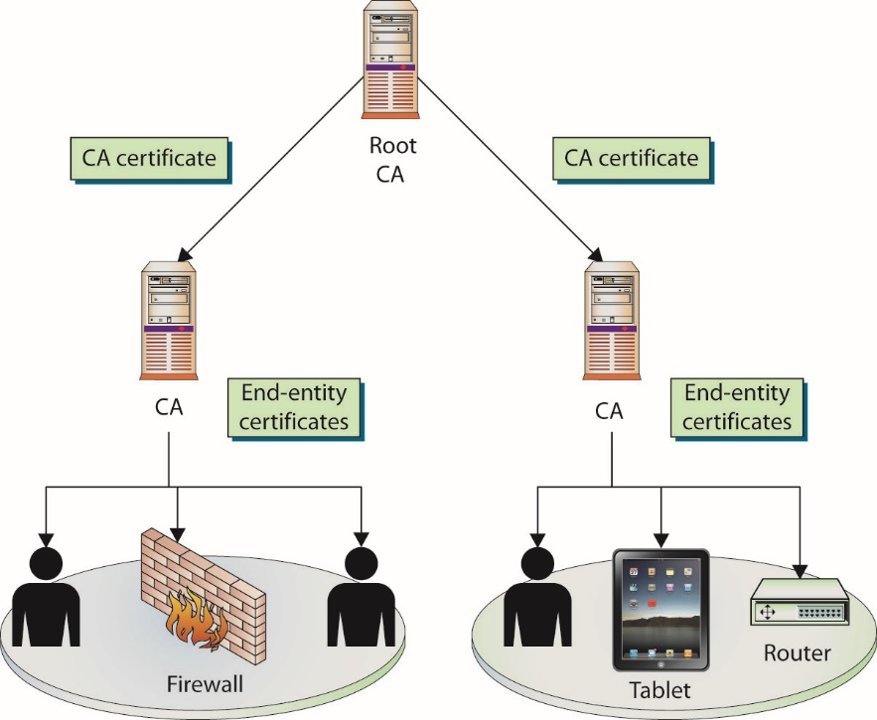
Figure 6.6 End-entity and CA certificates
Notes:
End-entity certificates are issued by a CA to a specific subject, such as Joyce, the Accounting department, or a firewall, as illustrated in Figure 6.6. An end-entity certificate is the identity document provided by PKI implementations.
A CA certificate can be self-signed, in the case of a standalone or root CA, or it can be issued by a superior CA within a hierarchical model. In the model in Figure 6.6, the superior CA gives the authority and allows the subordinate CA to accept certificate requests and generate the individual certificates itself. This may be necessary when a company needs to have multiple internal CAs, and different departments within an organization need to have their own CAs servicing their specific end-entities in their sections. In these situations, a representative from each department requiring a CA registers with the higher trusted CA and requests a Certificate Authority certificate. (Public and private CAs are discussed in the “Public Certificate Authorities” and “In-House Certificate Authorities” sections later in this chapter, as are the different trust models that are available for companies.)
A cross-certification certificate, or cross certificate, is used when independent CAs establish peer-to-peer trust relationships. Simply put, cross-certificates are a mechanism through which one CA can issue a certificate allowing its users to trust another CA.
Within sophisticated CAs used for high-security applications, a mechanism is required to provide centrally controlled policy information to PKI clients. This is often done by placing the policy information in a policy certificate.

Slide 119
Certificate Lifecycles
Keys and certificates should have lifetime settings.
Forces the user to register for a new certificate after a certain amount of time
There are tradeoff in determining the proper length.
Shorter lifetimes limit the ability of attackers to crack them.
Longer lifetimes lower system overhead.
More-sophisticated PKI implementations perform automated and often transparent key updates.
Avoids the time and expense of having users register for new certificates when old ones expire
Notes:
More-sophisticated PKI implementations perform automated and often transparent key updates to avoid the time and expense of having users register for new certificates when old ones expire. This means that the certificate and key pair has a lifecycle that must be managed. Certificate management involves administrating and managing each of these phases, including registration, certificate and key generation, renewal, and revocation. Additional management functions include CRL distribution, certificate suspension, and key destruction.

Slide 120
Registration and Generation
A key pair (public and private keys) is generated locally by an application and can be stored in a local key store on the user’s workstation.
A key pair created by a central key-generation server requires secure transmission of the keys to the user.
Key pair created on the centralized server can be stored on the user’s workstation or on the user’s smart card
Allows for more flexibility and mobility

Slide 121
Registration and Generation (continued)
The act of verifying that an individual indeed has the corresponding private key for a given public key is referred to as proof of possession.
Key regeneration and replacement is usually done to protect against threats.
The PKI administrator usually configures the minimum required key size that users must use to have a key generated for the first time, and then for each renewal.
Notes:
Not all public/private key pairs can be used for digital signatures, so asking the individual to sign a message and return it to prove that she has the necessary private key will not always work. If a key pair is used for encryption, the RA can send a challenge value to the individual, who, in turn, can use her private key to encrypt that value and return it to the RA. If the RA can successfully decrypt this value with the public key that was provided earlier, the RA can be confident that the individual has the necessary private key and can continue through the rest of the registration phase.
Key regeneration and replacement is usually done to protect against these types of threats, although as the processing power of computers increases and our knowledge of cryptography and new possible cryptanalysis-based attacks expands, key lifetimes may drastically decrease. As with everything within the security field, it is better to be safe now than to be surprised later and sorry.
The PKI administrator usually configures the minimum required key size that users must use to have a key generated for the first time, and then for each renewal. In most applications, there is a drop-down list of possible algorithms to choose from, and possible key sizes. The key size should provide the necessary level of security for the current environment. The lifetime of the key should be long enough that continual renewal will not negatively affect productivity, but short enough to ensure that the key cannot be successfully compromised.

Slide 122
CSR
A certificate signing request (CSR) is the actual request to a CA containing a public key and the requisite information needed to generate a certificate.
The CSR contains all of the identifying information that is to be bound to the key by the certificate generation process.

Slide 123
Renewal
The certificate itself has its own lifetime.
It can be different from the key pair’s lifetime.
The certificate’s lifetime is specified by the validity dates inserted into the digital certificate.
These are beginning and ending dates indicating the time period during which the certificate is valid.
The certificate cannot be used before the start date, and once the end date is met, the certificate is expired and a new certificate will need to be issued.

Slide 124
Renewal (continued)
A renewal process is different from the registration phase.
The RA assumes the individual has already successfully completed one registration round.
If the certificate has not actually been revoked, the original keys and certificate can be used to provide the necessary authentication information and proof of identity for the renewal phase.
The certificate may or may not need to change during the renewal process; this usually depends on why the renewal is taking place.
Notes:
If the certificate just expired and the keys will still be used for the same purpose, a new certificate can be generated with new validity dates. If, however, the key pair functionality needs to be expanded or restricted, new attributes and extensions may need to be integrated into the new certificate. These new functionalities may require more information to be gathered from the individual renewing the certificate, especially if the class changes or the new key uses allow for more powerful abilities.
This renewal process is required when the certificate has fulfilled its lifetime and its end validity date has been met.

Slide 125
Suspension
Instead of being revoked, a certificate can be suspended, meaning it is temporarily put on hold.
Reasons to suspend
Extended vacation – ensure certificate will not be compromised or used during that time
Suspicion that a private key might have been compromised
Notes:
Exam Tip: A certificate suspension can be a useful process tool while investigating whether or not a certificate should be considered to be valid.

Slide 126
Revocation
A certificate can be revoked when its validity needs to be ended before its actual expiration date is met.
Lost laptop or a smart card that stored a private key
Improper software implementation directly affecting the security of a private key
Social engineering attack obtained a private key
Data within certificate no longer applies to the individual
Employee left a company
Certificate revocation is permanent and final—once revoked a certificate cannot be reinstated.
Notes:
Once revoked, a certificate cannot be reinstated. This is to prevent an unauthorized reinstatement by someone who has unauthorized access to the key(s). A key pair can be reinstated for use by issuing a new certificate if at a later time the keys are found to be secure. The old certificate would still be void, but the new one would be valid.

Slide 127
Revocation (continued)
A certificate revocation list (CRL) is a list of serial numbers of certificates that have been revoked.
The CRL contains a statement indicating why the individual certificates were revoked and a date when the revocation took place.
The list usually contains all certificates that have been revoked within the lifetime of the CA.
Certificates that have expired are not the same as those that have been revoked.
An expired certificate means that its end validity date was reached.
Notes:
The format of the CRL message is also defined by X.509. The list is signed, to prevent tampering, and contains information on certificates that have been revoked and the reasons for their revocation. These lists can grow quite long, and as such, there are provisions for date timestamping the list and for issuing delta lists, which show changes since the last list was issued.

Slide 128
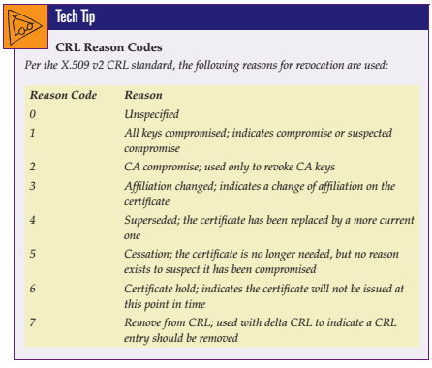

Slide 129
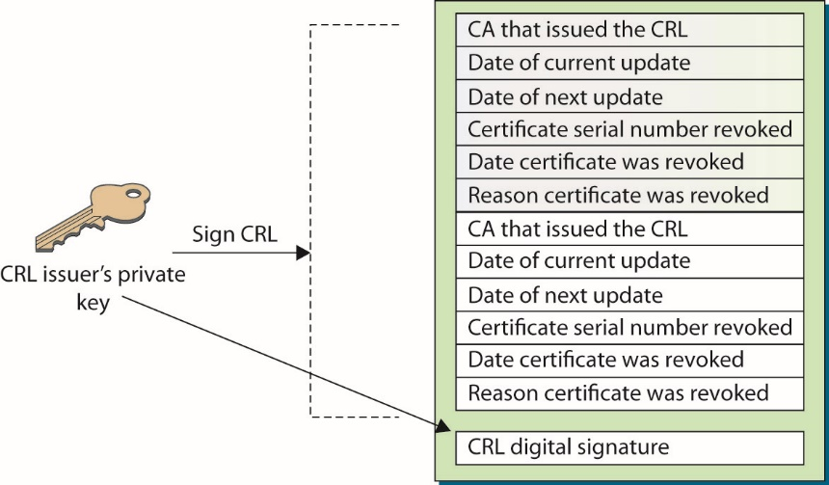
Figure 6.7 The CA digitally signs the CRL to protect its integrity.

Slide 130
Revocation (continued)
CRL distribution
CRLs can be requested by individuals or pushed down periodically.
CRLs can grow substantially in size.
The smaller the better to reduce load on resources.
Updates may be only changes to CRL.
A certificate might have an extension that points the validating user to the necessary CRL distribution point.
Notes:
CRL files can be requested by individuals who need to verify and validate a newly received certificate, or the files can be periodically pushed down (sent) to all users participating within a specific PKI. This means the CRL can be pulled (downloaded) by individual users when needed or pushed down to all users within the PKI on a timed interval.
It is also possible to first push down the full CRL and subsequently push down only delta CRLs, which contain only the changes to the original or base CRL. This can greatly reduce the amount of bandwidth consumed when updating CRLs.
In implementations where the CRLs are not pushed down to individual systems, the users’ PKI software needs to know where to look for the posted CRL that relates to the certificate it is trying to validate. The certificate might have an extension that points the validating user to the necessary CRL distribution point. The network administrator sets up the distribution points, and one or more points can exist for a particular PKI. The distribution point holds one or more lists containing the serial numbers of revoked certificates, and the user’s PKI software scans the list(s) for the serial number of the certificate the user is attempting to validate. If the serial number is not present, the user is assured that it has not been revoked. This approach helps point users to the right resource and also reduces the amount of information that needs to be scanned when checking that a certificate has not been revoked.

Slide 131
Revocation (continued)
Online Certificate Status Protocol (OCSP)
It is used for online revocation services.
It is a request and response protocol that obtains the serial number of the certificate being validated and reviews revocation lists for the client.
The protocol has a responder service that reports the status of the certificate back to the client.
Indicates revoked, valid, or unknown status
This protocol and service saves the client from having to find, download, and process the right lists.
Notes:
One last option for checking distributed CRLs is an online service. When a client user needs to validate a certificate and ensure that it has not been revoked, he can communicate with an online service that will query the necessary CRLs available within the environment. This service can query the lists for the client instead of pushing down the full CRL to each and every system. So if Joe receives a certificate from Stacy, he can contact an online service and send to it the serial number listed in the certificate Stacy sent. The online service would query the necessary CRLs and respond to Joe, indicating whether or not that serial number was listed as being revoked.

Slide 132
Key Destruction
Key pairs and certificates have set lifetimes
They will expire at some specified time.
It is important that the certificates and keys are properly destroyed when that time comes, wherever the keys are stored.
The goal is to make sure that no one can gain access to a key after its lifetime has ended and use that key for malicious purposes.

Slide 133
Module 4 Cryptography and Public Key Infrastructure – Part 4

Slide 134
Certificate Repositories
A certificate repository describes a centralized directory that can be accessed by a subset of individuals.
Directories are usually Lightweight Directory Access Protocol (LDAP)-compliant.
Can be accessed and searched via an LDAP query from an LDAP client.
A certificate repository is a holding place for individuals’ certificates and public keys that are participating in a particular PKI environment.
Notes:
The security requirements for repositories themselves are not as high as those needed for actual CAs and for the equipment and software used to carry out CA functions. Since each certificate is digitally signed by the CA, if a certificate stored in the certificate repository is modified, the recipient will be able to detect this change and know not to accept the certificate as valid.

Slide 135
Trust and Certificate Verification
Use PKI if you do not automatically trust individuals you do not know.
Use a trusted third party to vouch for the other individual so confidence can be instilled and sensitive communication can take place.
When a user trusts a CA, she will download that CA’s digital certificate and public key and store them on her local computer.
Trusted certificate authorities can be found in your browser’s list.
Notes:
We need to use a PKI if we do not automatically trust individuals we do not know. Security is about being suspicious and being safe, so we need a third party that we do trust to vouch for the other individual before confidence can be instilled and sensitive communication can take place.

Slide 136
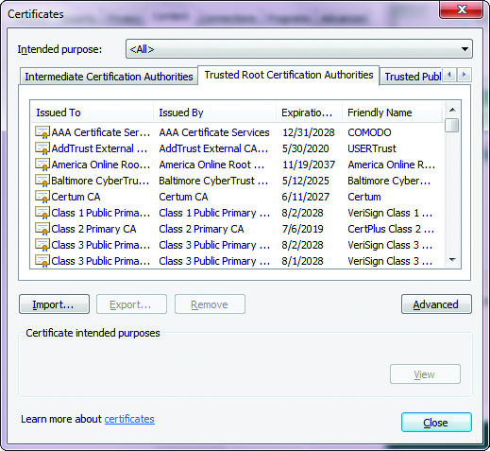
Figure 6.8 Browsers have a long list of CAs configured to be trusted by default.
Check out certificate management in your browser Google Chrome, Firefox or Microsoft Edge
Notes:
When a user chooses to trust a CA, she will download that CA’s digital certificate and public key, which will be stored on her local computer. Most browsers have a list of CAs configured to be trusted by default, so when a user installs a new web browser, several of the most well-known and most trusted CAs will be trusted without any change of settings. An example of this listing is shown in Figure 6.8.
In the Microsoft CAPI environment, the user can add and remove CAs from this list as needed. In production environments that require a higher degree of protection, this list will be pruned, and possibly the only CAs listed will be the company’s internal CAs. This ensures that digitally signed software will be automatically installed only if it was signed by the company’s CA. Other products, such as Entrust, use centrally controlled policies to determine which CAs are to be trusted, instead of expecting the user to
make these critical decisions.

Slide 137
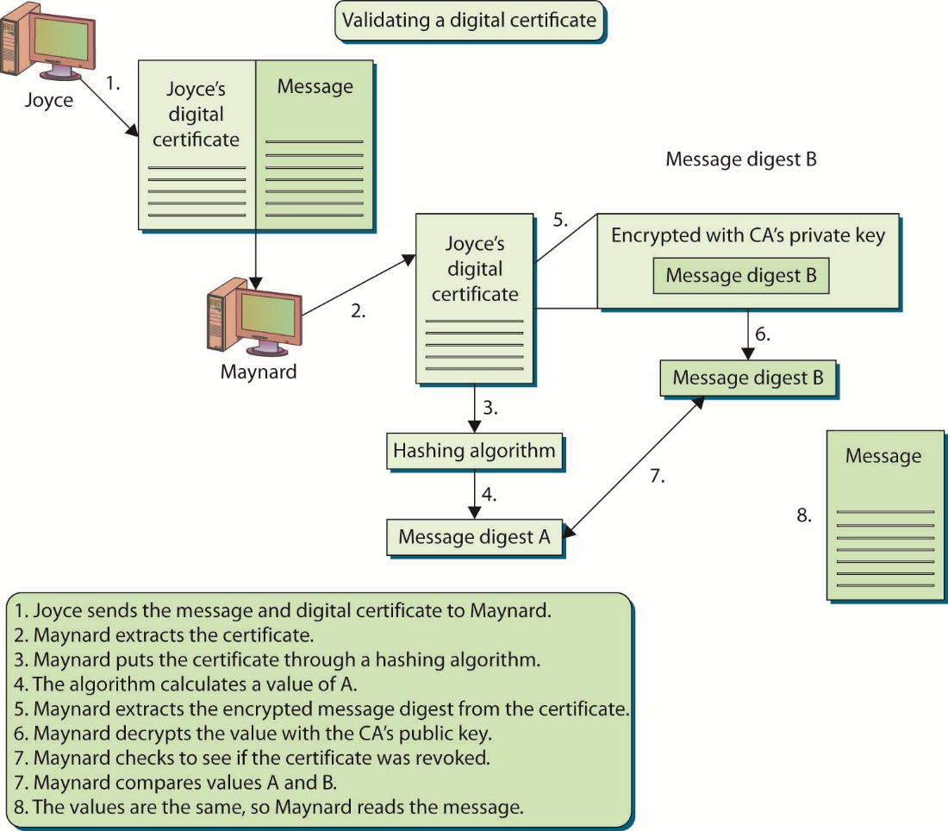
Figure 6.9 Steps for verifying the authenticity and integrity of a certificate
Notes:
A number of steps are involved in checking the validity of a message. Suppose, for example, that Maynard receives a digitally signed message from Joyce, who he does not know or trust. Joyce has also included her digital certificate with her message, which has her public key embedded within it. Before Maynard can be sure of the authenticity of this message, he has some work to do. The steps are illustrated in Figure 6.9.

Slide 138
Centralized and Decentralized Infrastructures
In a decentralized approach, software on individual computers generates and stores cryptographic keys local to the systems themselves.
In a centralized infrastructure, the keys are generated and stored on a central server, and the keys are transmitted to the individual systems as needed.
Easier to back up the keys and implement key recovery procedures
Notes:
If a company uses an asymmetric algorithm that is resource-intensive to generate the public/private key pair, and if large (and resource-intensive) key sizes are needed, then the individual computers may not have the necessary processing power to produce the keys in an acceptable fashion. In this situation, the company can choose a centralized approach in which a very high-end server with powerful processing abilities is used, probably along with a hardware-based random number generator.

Slide 139
Centralized and Decentralized Infrastructures (continued)
Centralized infrastructure disadvantages
Technology is needed to send keys in an encrypted manner.
Encryption ensures keys’ integrity, and ensure intended user is receiving the key.
Fault tolerance or redundancy mechanism is needed for server that centrally stores the keys.
To provide true authenticity and nonrepudiation, digital signature public/private key pair should not be generated at a centralized server.
Notes:
One other issue pertains to how the keys will actually be used. If a public/private key pair is being generated for digital signatures, and if the company wants to ensure that it can be used to provide true authenticity and nonrepudiation, the keys should not be generated at a centralized server. This would introduce doubt that only the one person had access to a specific private key. It is better to generate end-user keys on a local machine to eliminate doubt about who did the work and “owns” the keys.
If a company uses smart cards to hold users’ private keys, each private key often has to be generated on the card itself and cannot be copied for archiving purposes. This is a disadvantage of the centralized approach. In addition, some types of applications have been developed to create their own public/private key pairs and do not allow other keys to be imported and used. This means the keys would have to be created locally by these applications, and keys from a central server could not be used. These are just some of the considerations that need to be evaluated before any decision is made and implementation begins.

Slide 140
Hardware Security Modules
A hardware security module (HSM) is a physical device that safeguards cryptographic keys.
HSMs enable a higher level of security for the use of keys, including generation and authentication.
In most situations, HSM solutions are used only for the most critical and sensitive keys, which are the root key and possibly the intermediate CA private key.
If those keys are compromised, the whole security of the PKI is gravely threatened.
Notes:
If a person obtained a root CA private key, she could digitally sign any certificate, and that certificate would be quickly accepted by all entities within the environment. Such an attacker might be able to create a certificate that has extremely high privileges, perhaps allowing her to modify bank account information in a financial institution, and no alerts or warnings would be initiated because the ultimate CA, the root CA, signed it.

Slide 141
Private Key Protection
The private key needs to stay private.
Digital signature created solely for the purpose of proving who sent a particular message by using a private key.
Key store is a storage area for the private key.
Key store usually created by the application registering for a certificate.
Many applications do not require strong password to protect the key store.
If digital signatures will be used for legal purposes, these points and others may need to be audited to ensure that true authenticity and nonrepudiation are provided.
Notes:
Because a private key is a crucial component of any PKI implementation, the key itself should contain the necessary characteristics and be protected at each stage of its life. The following list sums up the characteristics and requirements of proper private key use:
The key size should provide the necessary level of protection for the environment.
The lifetime of the key should correspond with how often it is used and the sensitivity of the data it is protecting.
The key should be changed at the end of its lifetime and not used past its allowed lifetime.
Where appropriate, the key should be properly destroyed at the end of its lifetime.
The key should never be exposed in clear text.
No copies of the private key should be made if it is being used for digital signatures.
The key should not be shared.
The key should be stored securely.
Authentication should be required before the key can be used.
The key should be transported securely.
Software implementations that store and use the key should be evaluated to ensure they provide the necessary level of protection.

Slide 142
Key Recovery
Two systems are important for backing up and restoring cryptographic keys:
Key archiving is a way of backing up keys and securely storing them in a repository.
Key recovery is the process of restoring lost keys to the users or the company.
If keys are backed up and stored in a centralized computer, this system must be tightly controlled.
It is usually unwise to authorize a single person to be able to recover all the keys within the environment.
Notes:
Exam Tip: Key recovery is a process that allows for lost keys to be recovered. Key escrow is a process of giving keys to a third party so that they can decrypt and read sensitive information when this need arises.

Slide 143
Key Recovery (continued)
Dual control approach to key recovery is referred to as the m of n authentication.
Number of people involved in key recovery process is n.
At least m (smaller than n) must be involved before the task can be completed
Too many people for m increases issues associated with availability; too few increases risk of a small number of people colluding to compromise a secret.
Goal is to minimize fraudulent or improper use of access and permissions.
All key recovery procedures should be highly audited.
Notes:
Exam Tip: Recovery agent is the term for an entity that is given a public key certificate for recovering user data that is encrypted. This is the most common type of recovery policy used in PKI but adds the risk of the recovery agent having access to secured information
If a company is going to perform key recovery and maintain a key recovery system, it will generally back up only the key pair used to encrypt data, not the key pairs that are used to generate digital signatures. The reason that a company archives keys is to ensure that if a person leaves the company, falls off a cliff, or for some reason is unavailable to decrypt important company information, the company can still get to its company-owned data. This is just a matter of the organization protecting itself. A company would not need to be able to recover a key pair that is used for digital signatures, since those keys are to be used only to prove the authenticity of the individual who sent a message. A company would not benefit from having access to those keys and really should not have access to them, since they are tied to one individual for a specific purpose.
All key recovery procedures should be highly audited. The audit logs should capture at least what keys were recovered, who was involved in the process, and the time and date. Keys are an integral piece of any encryption cryptosystem and are critical to a PKI environment, so you need to track who does what with them.

Slide 144
Key Recovery (continued)
Dual control can be used as part of a system to back up and archive data encryption keys.
PKI systems can be configured to require multiple individuals in any key recovery process.
Separation of duties means that one person cannot complete a critical task by himself.
Requiring two individuals to recover a lost key together is called dual control.
This means two people must be present to carry out a specific task.

Slide 145
Key Escrow
Key escrow is the process of giving keys to a third party so that they can decrypt and read sensitive information if the need arises.
Almost always pertains to handing over encryption keys to the government, or to another higher authority, so keys can be used to collect evidence during investigations.
Two reasons employer may escrow a key pair:
Keys are property of the enterprise, issued to the worker for use.
The firm may have need for them after an employee leaves the firm.
Notes:
Exam Tip: Key escrow, allowing another trusted party to hold a copy of a key, has long been a controversial topic. This essential business process provides continuity should the authorized key-holding party leave an organization without disclosing keys. The security of the escrowed key is a concern, and it needs to be managed at the same security level as for the original key.
Several movements, supported by parts of the U.S. government, would require all or many people residing in the United States to hand over copies of the keys they use to encrypt communication channels. The movement in the late 1990s behind the Clipper chip is the most well-known effort to implement this requirement and procedure. It was suggested that all American-made communication devices should have a hardware encryption chip within them. The chip could be used to encrypt data going back and forth between two individuals, but if a government agency decided that it should be able to eavesdrop on this dialog, it would just need to obtain a court order. If the court order was approved, a law enforcement agent would take the order to two escrow agencies, each of which would have a piece of the key that was necessary to decrypt this communication information. The agent would obtain both pieces of the key and combine them, which would allow the agent to listen in on the encrypted communication outlined in the court order.
The Clipper chip standard never saw the light of day because it seemed too “Big Brother” to many American citizens. But the idea was that the encryption keys would be escrowed to two agencies, meaning that each agency would hold one piece of the key. One agency could not hold the whole key, because it could then use this key to wiretap people’s conversations illegally. Splitting up the key is an example of separation of duties, put into place to try and prevent fraudulent activities.

Slide 146
Public Certificate Authorities
Public CAs are already established and being used by many other individuals and companies.
Specialize in verifying individual identities and creating and maintaining their certificates
Issue certificates that are not bound to specific companies or departments
Examples of public CAs include:
VeriSign (including GeoTrust and Thawte), Entrust, and Go Daddy

Slide 147
Public Certificate Authorities (continued)
Advantage of using a public CA is that it is usually well known and easily accessible to many people.
Certificate policy (CP) allows the company to decide what certification classes are acceptable and how they will be used within the organization.

Slide 148
In-House Certificate Authorities
An in-house CA is implemented, maintained, and controlled by the company that implemented it.
This type of CA can be used to create certificates for internal employees, devices, applications, partners, and customers.
This approach gives the company complete control over how individuals are identified, what certification classifications are created, who can and cannot have access to the CA, and how the certifications can be used.

Slide 149
Choosing Between a Public CA and an In-House CA
Factors need to be identified and taken into accounted.
Time and cost need to be considered.
Public CAs already have the necessary equipment, skills, and technologies.
Each company has various goals, security requirements, functionality needs, budgetary restraints, and ideologies.
Some companies do not trust an outside authority to generate and maintain their company’s certificates.
Notes:
Each company is unique, with various goals, security requirements, functionality needs, budgetary restraints, and ideologies. The decision of whether to use a private CA or an in-house CA depends on the expansiveness of the PKI within the organization, how integrated it will be with different business needs and goals, its interoperability with a company’s current technologies, the number of individuals who will be participating, and how it will work with outside entities. This could be quite a large undertaking that ties up staff, resources, and funds, so a lot of strategic planning is required, and what will and won’t be gained from a PKI should be fully understood before the first dollar is spent on the implementation.

Slide 150
Outsourced Certificate Authorities
Usually, the more complex parts (the CA, RA, CRL, and key recovery mechanisms) are outsourced.
Level of trust the company willing to give to service provider and level of risk willing to accept must be determined.
Large vertical markets can have their own outsourced PKI environments set up to split costs and follow industry-specific standards.
A set of standards can be drawn up about how each different facility should integrate its own infrastructure and how it should integrate with the centralized PKI components.
Notes:
Some large vertical markets have their own outsourced PKI environments set up because they share similar needs and usually have the same requirements for certification types and uses. This allows several companies within the same market to split the costs of the necessary equipment, and it allows for industry-specific standards to be drawn up and followed.

Slide 151
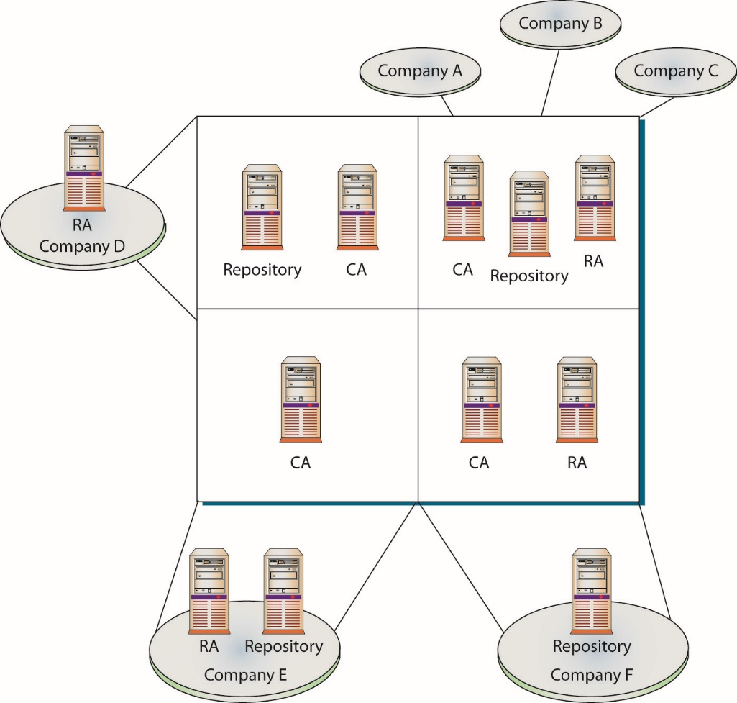
Figure 6.10 A PKI service provider (represented by the four boxes) can offer different PKI components to companies.
Notes:
Figure 6.10 illustrates how one outsourced service provider can offer different PKI components and services to different companies, and how companies within one vertical market can share the same resources.

Slide 152
Tying Different PKIs Together
More than one CA may be needed for a specific PKI to work properly.
Several requirements must be met for different PKIs to intercommunicate.
Requirements need to be understood, addressed, and planned for to control added complexity.
Selecting the right trust model will give the company a solid foundation from the beginning, instead of trying to add structure to an inaccurate and inadequate plan later on.
Notes:
In some cases, more than one CA may be needed for a specific PKI to work properly, and several requirements must be met for different PKIs to intercommunicate. Here are some examples:
A company wants to be able to communicate seamlessly with its suppliers, customers, or business partners via a PKI.
One department within a company has higher security requirements than all other departments and thus needs to configure and control its own CA.
One department needs to have specially constructed certificates with unique fields and usages.
Different parts of an organization want to control their own pieces of the network and the CA that is encompassed within it.
The number of certificates that need to be generated and maintained would overwhelm one CA, so multiple CAs must be deployed.
The political culture of a company inhibits one department from being able to control elements of another department.
Enterprises are partitioned geographically, and different sites need their own local CA.

Slide 153
Trust Models
A trust domain is a construct of systems, personnel, applications, protocols, technologies, and policies that work together to provide a certain level of protection.
Most trust domains need to communicate with other, less-trusted domains.
Must figure out how much two different domains should trust each other, and how to implement and configure an infrastructure that would allow these two domains to communicate in a way that will not allow security compromises or breaches.
Notes:
There are several forms of trust models associated with certificates. Hierarchical, peer-to-peer, and hybrid are the primary forms, with the web of trust being a form of hybrid. Each of these models has a useful place in the PKI architecture under different circumstances.
In the nondigital world, it is difficult to figure out who to trust, how to carry out legitimate business functions, and how to ensure that one is not being taken advantage of or lied to. Jump into the digital world and add protocols, services, encryption, CAs, RAs, CRLs, and differing technologies and applications, and the business risks can become overwhelming and confusing. So start with a basic question: What criteria will we use to determine who we trust and to what degree?

Slide 154
Trust Models (continued)
The trust anchor is the agreed-upon trusted third party.
Two separate trust domains involved if two companies need to communicate using their individual PKIs or two departments within the same company use different CAs.
The users and devices from these different trust domains need to communicate with each other.
They need to exchange certificates and public keys.
Trust anchors must be identified and a communication channel constructed and maintained.
Notes:
There are several forms of trust models associated with certificates. Hierarchical, peer-to-peer, and hybrid are the primary forms, with the web of trust being a form of hybrid. Each of these models has a useful place in the PKI architecture under different circumstances.
In the nondigital world, it is difficult to figure out who to trust, how to carry out legitimate business functions, and how to ensure that one is not being taken advantage of or lied to. Jump into the digital world and add protocols, services, encryption, CAs, RAs, CRLs, and differing technologies and applications, and the business risks can become overwhelming and confusing. So start with a basic question: What criteria will we use to determine who we trust and to what degree?

Slide 155
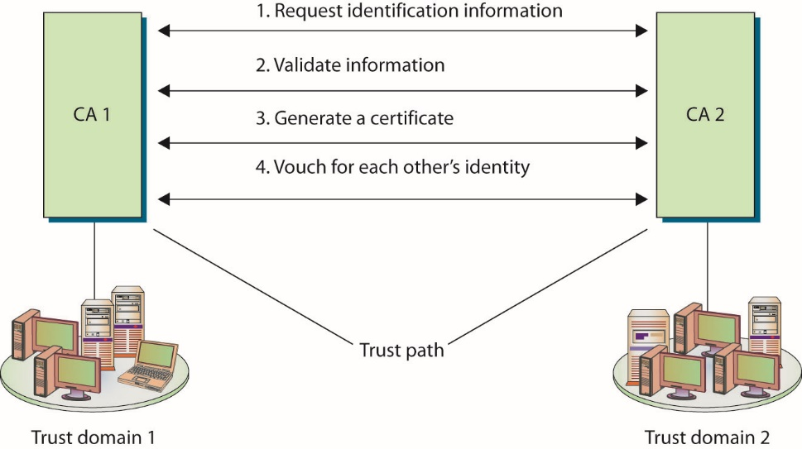
Figure 6.11 A trust relationship can be built between two trust domains to set up a communication channel.
Notes:
As illustrated in Figure 6.11, all the users and devices in trust domain 1 trust their own CA, CA 1, which is their trust anchor. All users and devices in trust domain 2 have their own trust anchor, CA 2. The two CAs have exchanged certificates and trust each other, but they do not have a common trust anchor between them.

Slide 156
Trust Models (continued)
Trust models describe and outline the trust relationships between the different CAs and different environments.
Indicate where the trust paths reside
Trust models and paths need to be thought out before implementation.
Restrict and control access properly
Ensure as few trust paths as possible are used
Several different trust models can be used:
Hierarchical, peer-to-peer, and hybrid models

Slide 157
Trust Models (continued)
A trust relationship must be established between two issuing authorities (CAs).
One or both of the CAs issue a certificate for the other CA’s public key.
Each CA validates the other CA’s identification information and generates a certificate containing a public key for that CA to use.
A trust path established between the two entities.
The trust path can be unidirectional or bidirectional – either the two CAs trust each other (bidirectional) or only one trusts the other (unidirectional).

Slide 158
Trust Models (continued)
The hierarchical trust model is a basic hierarchical structure that contains a root CA, intermediate CAs, leaf CAs, and end-entities.
The configuration is that of an inverted tree.
The root CA is the ultimate trust anchor for all other entities in this infrastructure.
Root CA generates certificates for the intermediate CAs, which in turn generate certificates for the leaf CAs; leaf CAs generate certificates for the end-entities.
Subordinate CAs are subordinate to the CA they reference.
Notes:
Intermediate CAs function to transfer trust between different CAs. These CAs are referred to as subordinate CAs because they are subordinate to the CA that they reference. The path of trust is walked up from the subordinate CA to the higher-level CA; in essence the subordinate CA is using the higher-level CA as a reference.

Slide 159
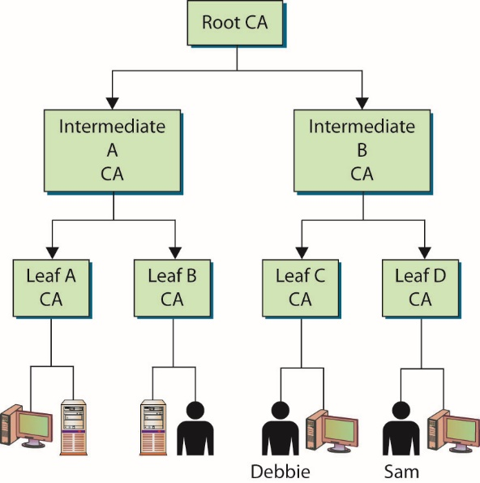
Figure 6.12 The hierarchical trust model outlines trust paths.
Notes:
No bidirectional trusts exist—they are all unidirectional trusts, as indicated by the one-way arrows. Since no other entity can certify and generate certificates for the root CA, it creates a self-signed certificate. This means that the certificate’s Issuer and Subject fields hold the same information, both representing the root CA, and the root CA’s public key will be used to verify this certificate when that time comes. This root CA certificate and public key are distributed to all entities within this trust model.

Slide 160
Trust Models (continued)
Walking the certificate path
Following the certificate path means the client software had to continue to track down and collect certificates until it came upon a self-signed certificate.
A self-signed certificate indicates that it was signed by a root CA.
Simplistic trust model works well within an enterprise that easily follows a hierarchical organizational chart.
Many companies cannot use this trust model because different departments or offices require their own trust anchors.
Notes:
When a user in one trust domain needs to communicate with a user in another trust domain, one user will need to validate the other’s certificate. This sounds simple enough, but what it really means is that each certificate for each CA, all the way up to a shared trusted anchor, also must be validated.
This type of simplistic trust model works well within an enterprise that easily follows a hierarchical organizational chart, but many companies cannot use this type of trust model because different departments or offices require their own trust anchors. These demands can be derived from direct business needs or from interorganizational politics. This hierarchical model might not be possible when two or more companies need to communicate with each other. Neither company will let the other’s CA be the root CA, because each does not necessarily trust the other entity to that degree. In these situations, the CAs will need to work in a peer-to-peer relationship instead of in a hierarchical relationship.

Slide 161
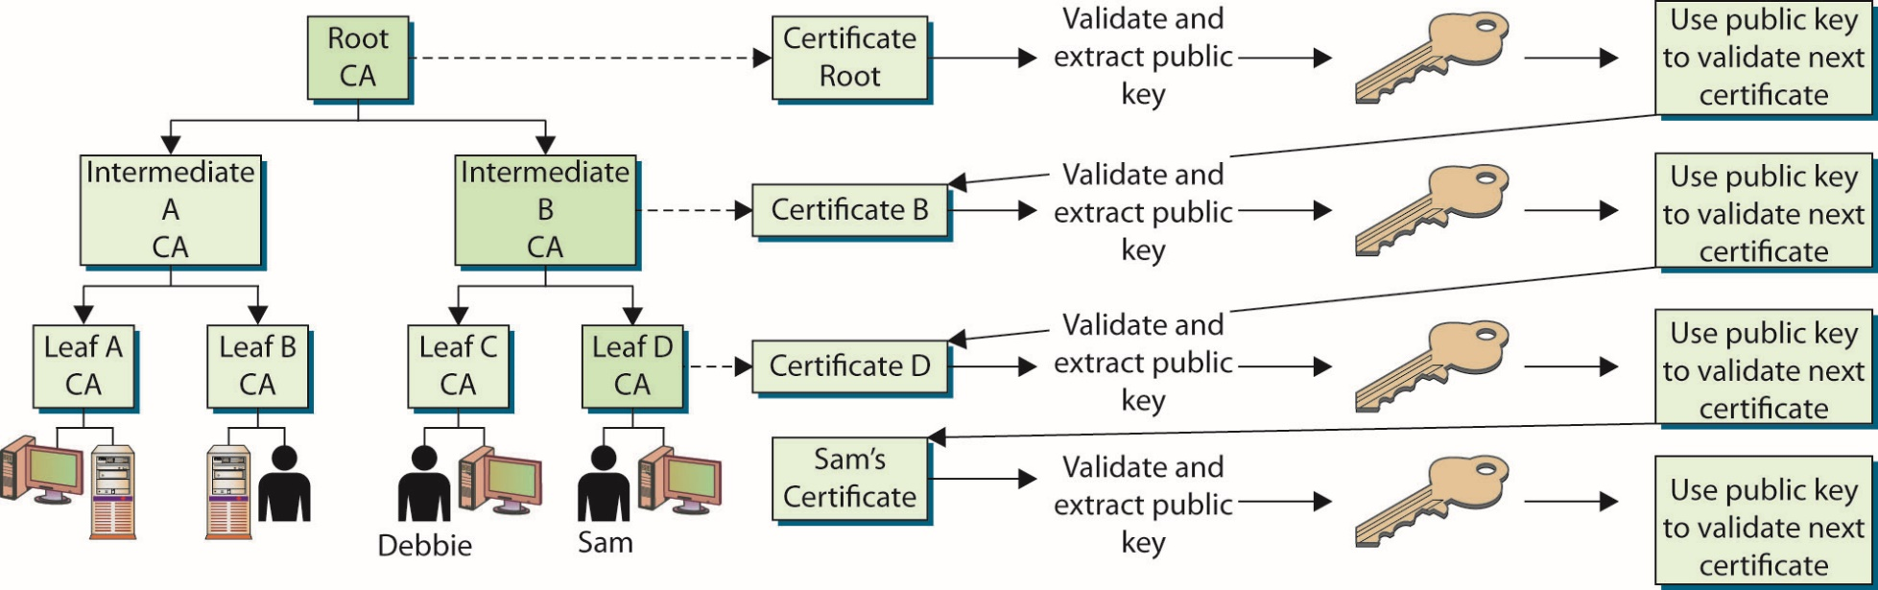
Figure 6.13 Verifying each certificate in a certificate path
Notes:
Debbie tracks down Leaf D CA’s certificate and public key, but she now needs to verify this CA’s certificate, so she looks at the Issuer field, which indicates that Leaf D CA’s certificate was issued by Intermediate B CA. Debbie now needs to get Intermediate B CA’s certificate and public key. Debbie’s client software tracks this down and sees that the issuer for Intermediate B CA is the root CA, for which she already has a certificate and public key. So Debbie’s client software had to follow the certificate path, meaning it had to continue to track down and collect certificates until it came upon a self-signed certificate. A self-signed certificate indicates that it was signed by a root CA, and Debbie’s software has been configured to trust this entity as her trust anchor, so she can stop there.
Figure 6.13 illustrates the steps Debbie’s software had to carry out just to be able to verify Sam’s certificate.

Slide 162
Trust Models (continued)
In a peer-to-peer trust model, one CA is not subordinate to another CA, and no established trusted anchor between the CAs is involved.
The end-entities look to their issuing CA as their trusted anchor, but different CAs will not have a common anchor.
Cross-certification occurs when two different CAs certify the public key for each other creating a bidirectional trust.
Main drawback is scalability.
A fully connected mesh architecture has each CA directly connected to and has a bidirectional trust relationship with every other CA.

Slide 163
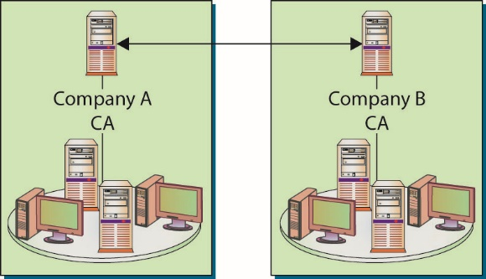
Figure 6.14 Cross-certification creates a peer-to-peer PKI model.
Notes:
Figure 6.14 illustrates this a peer-to-peer trust model. The two different CAs will certify the public key for each other, which creates a bidirectional trust. This is referred to as cross-certification, since the CAs are not receiving their certificates and public keys from a superior CA, but instead are creating them for each other.

Slide 164
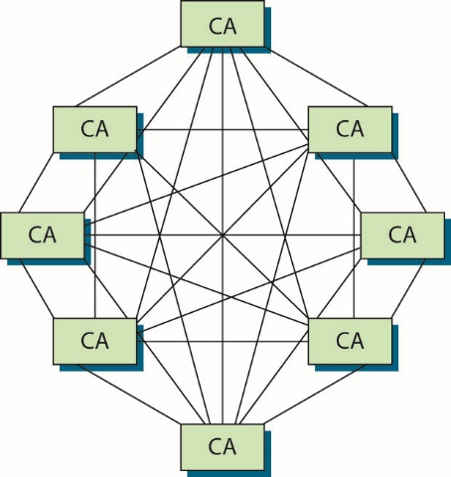
Figure 6.15 Scalability is a drawback in cross-certification models.
Notes:
One of the main drawbacks to this model is scalability. Each CA must certify every other CA that is participating, and a bidirectional trust path must be implemented. If one root CA were certifying all the intermediate CAs, scalability would not be as much of an issue.
Figure 6.15 represents a fully connected mesh architecture, meaning that each CA is directly connected to and has a bidirectional trust relationship with every other CA. As you can see in this illustration, the complexity of this setup can become overwhelming.

Slide 165
Trust Models (continued)
In a hybrid trust model, the two companies have their own internal hierarchical models and are connected through a peer-to-peer model using cross-certification.
Another option is to implement a bridge CA responsible for issuing cross-certificates for all connected CAs and trust domains.
The bridge is not considered a root or trust anchor, but merely the entity that generates and maintains the cross-certification for the connected environments.

Slide 166
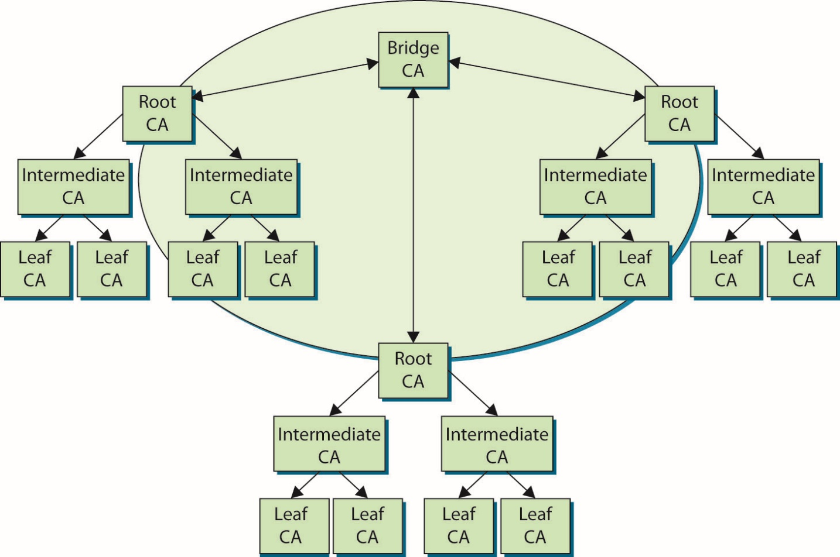
Figure 6.16 A bridge CA can control the cross-certification procedures.
Notes:
Figure 6.16 illustrates the role that a bridge CA could play – it is responsible for issuing cross-certificates for all connected CAs and trust domains. The bridge is not considered a root or trust anchor, but merely the entity that generates and maintains the cross-certification for the connected environments.

Slide 167
Certificate-Based Threats
Attacks prey on user false sense of security.
Industry responded with a high-assurance certificate that is signed and recognized by browsers.
Forging a false certificate is challenging because of the public key signing of certificates by CAs.
Hacker must install a false, self-signed root certificate.
This attack preys on the fact that end users do not know the contents of their root certificate store, nor do they have a means to validate changes.
Attack thwarted by locking down the certificate store and validating against a white list.
Notes:
Although certificates bring much capability to security through practical management of trust, they also can present threats. Because much of the actual work is done behind the scenes, without direct user involvement, a false sense of security might ensue. End users might assume that if an HTTPS connection was made with a server, they are securely connected to the proper server. Spoofing, phishing, pharming, and a wide range of sophisticated attacks prey on this assumption.

Slide 168
Stolen Certificates
Stolen certificates used in multiple cases of computer intrusions/system attacks.
Specially crafted malware designed to steal both private keys and digital certificates from machines.
Zeus bot has functionality to perform this task.
The Stuxnet attack on the Iranian nuclear production facility used stolen certificates from third parties.
After the Sony Pictures Entertainment attack became public in 2014, malware using Sony certificates appeared.

